Slide 1
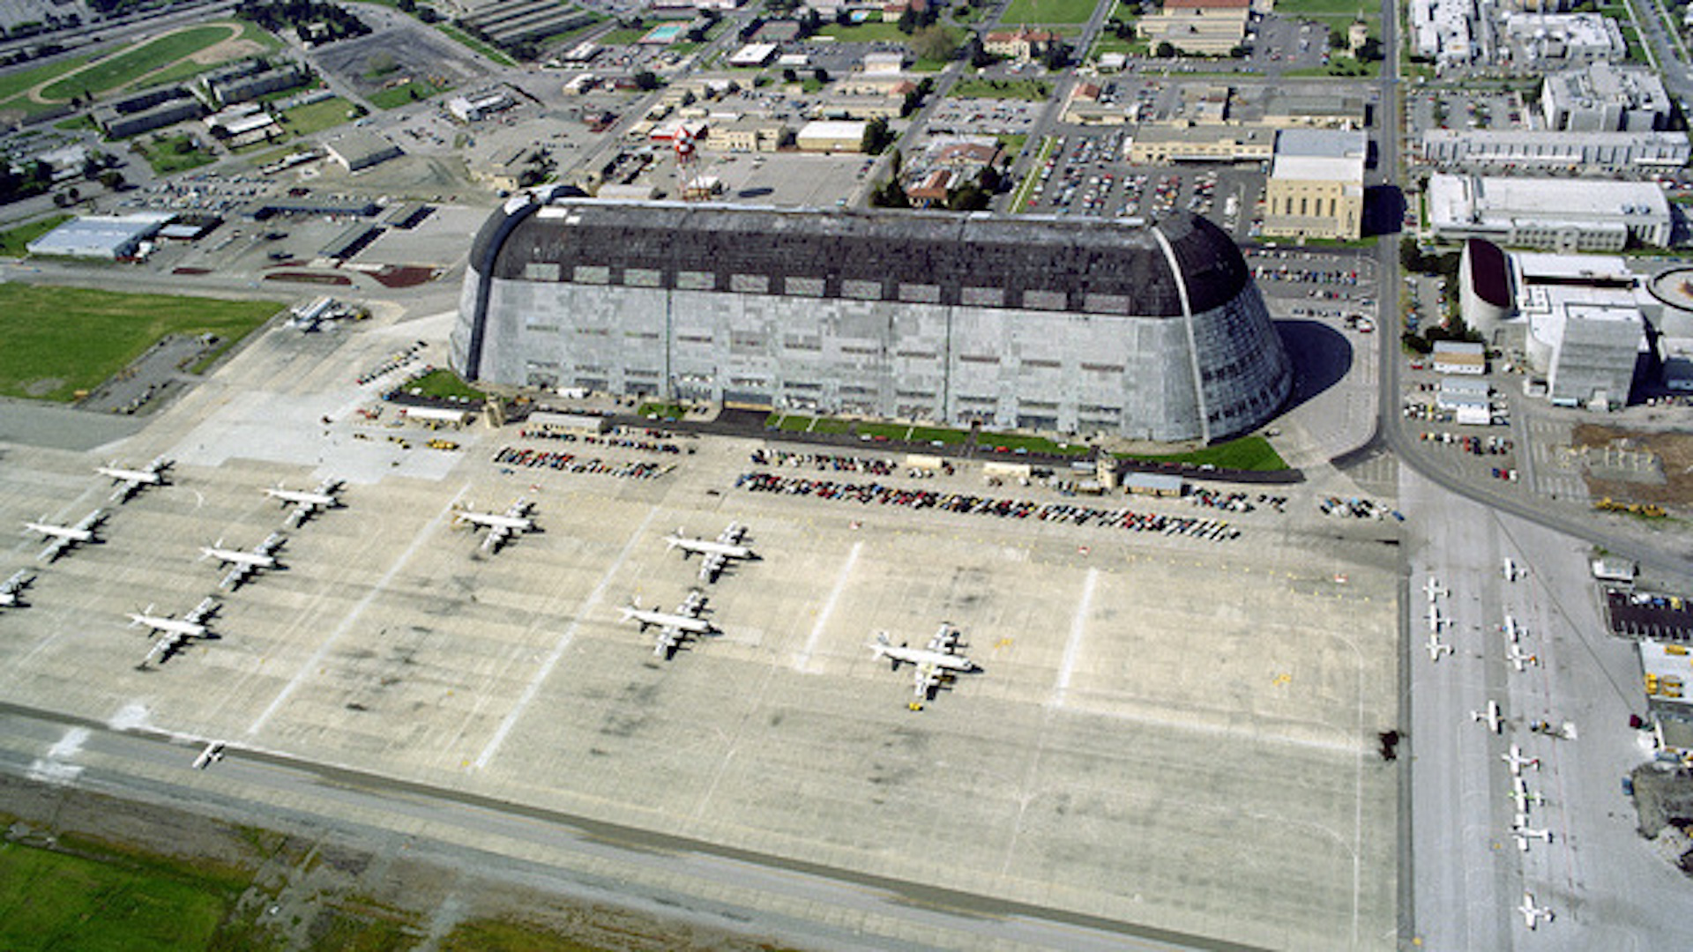

Short Description of Lockheed P-3 Aircraft and it’s Relationship with Moffett Field

Slide 2
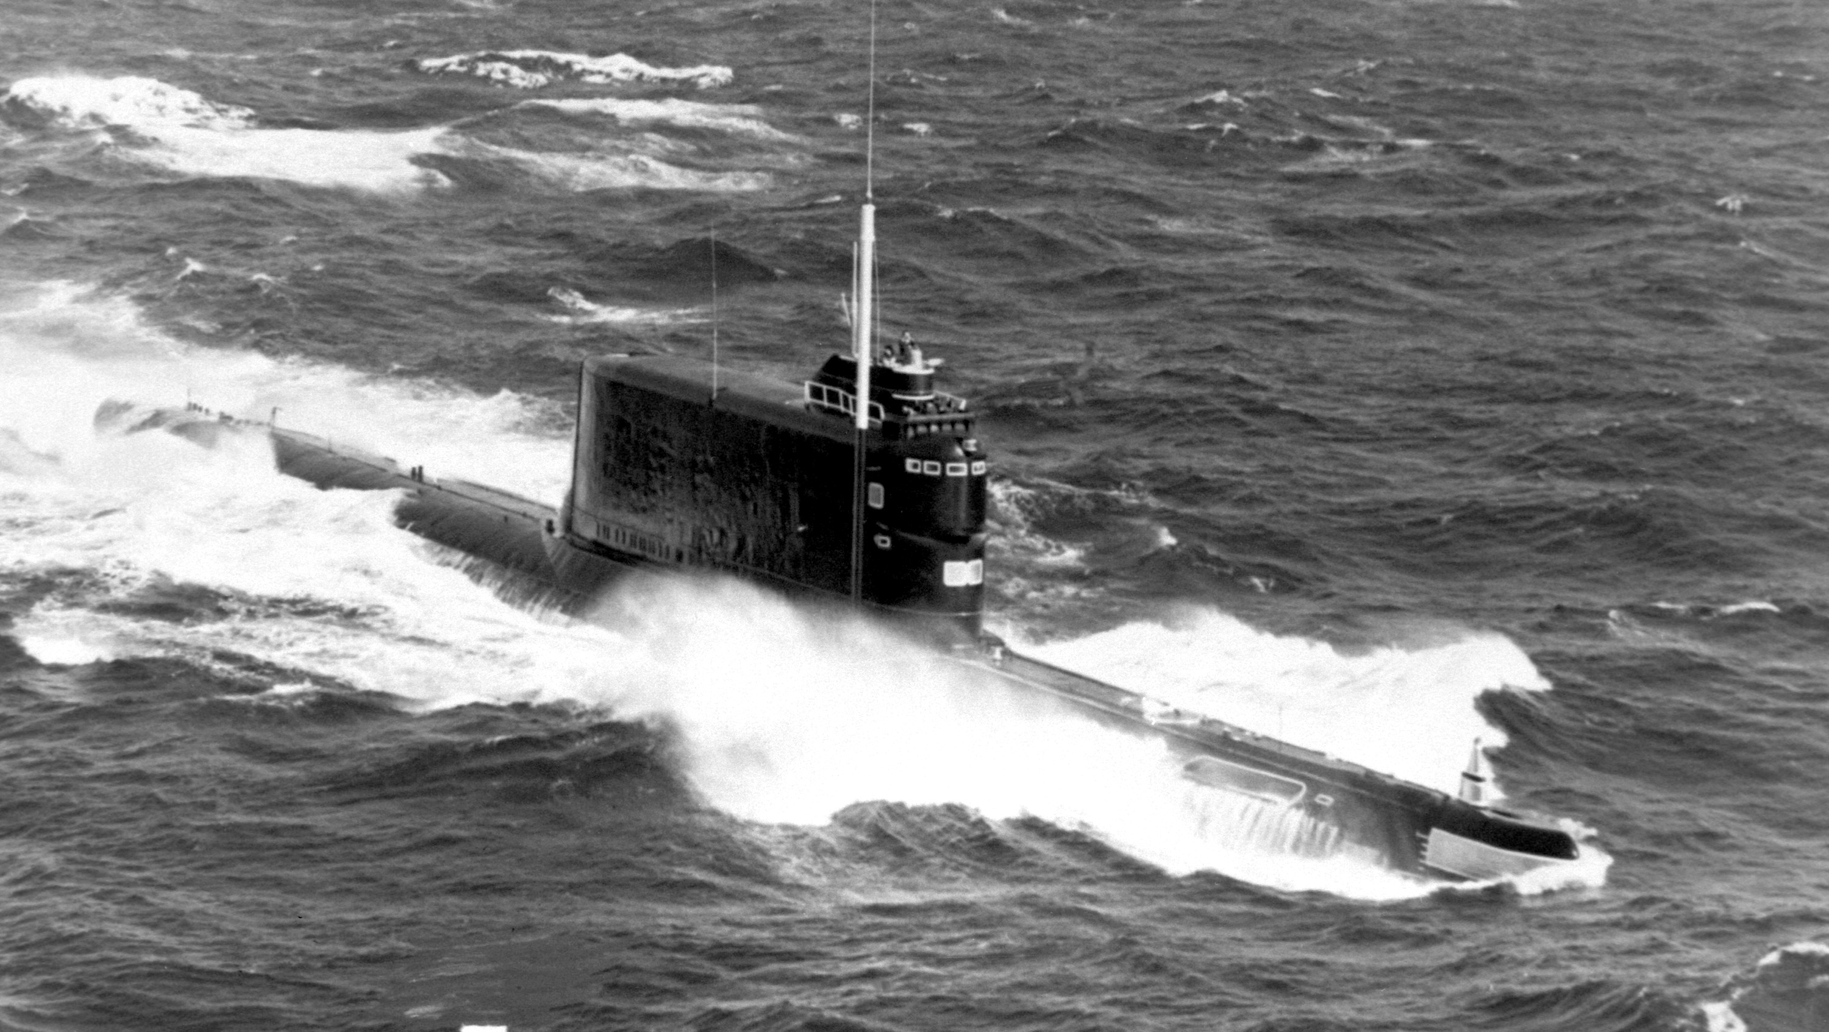
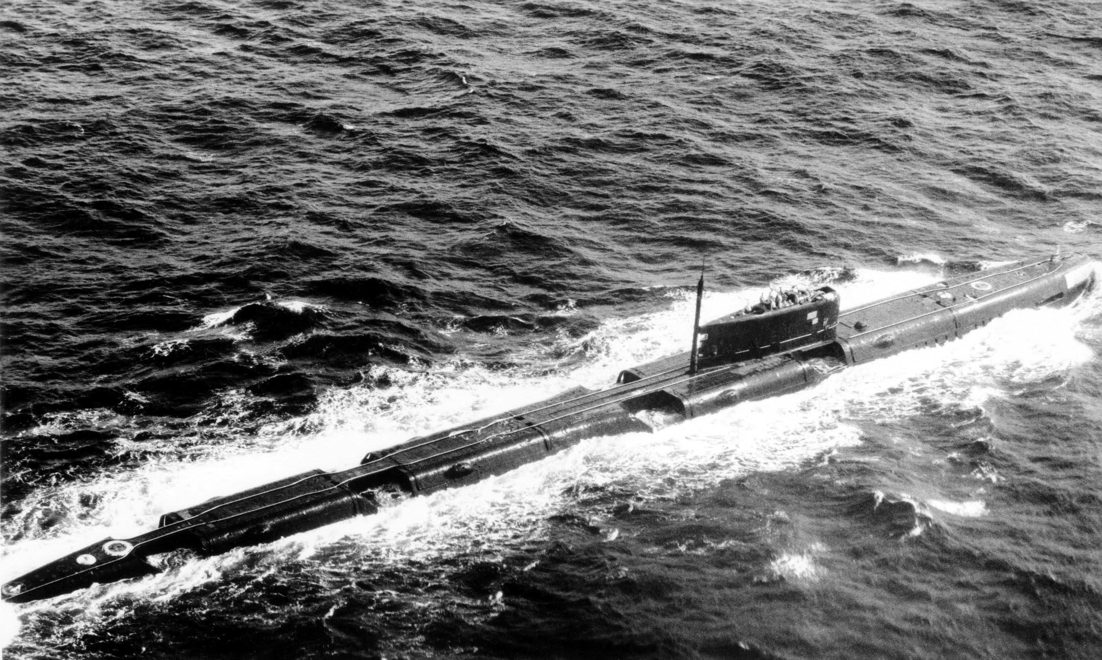
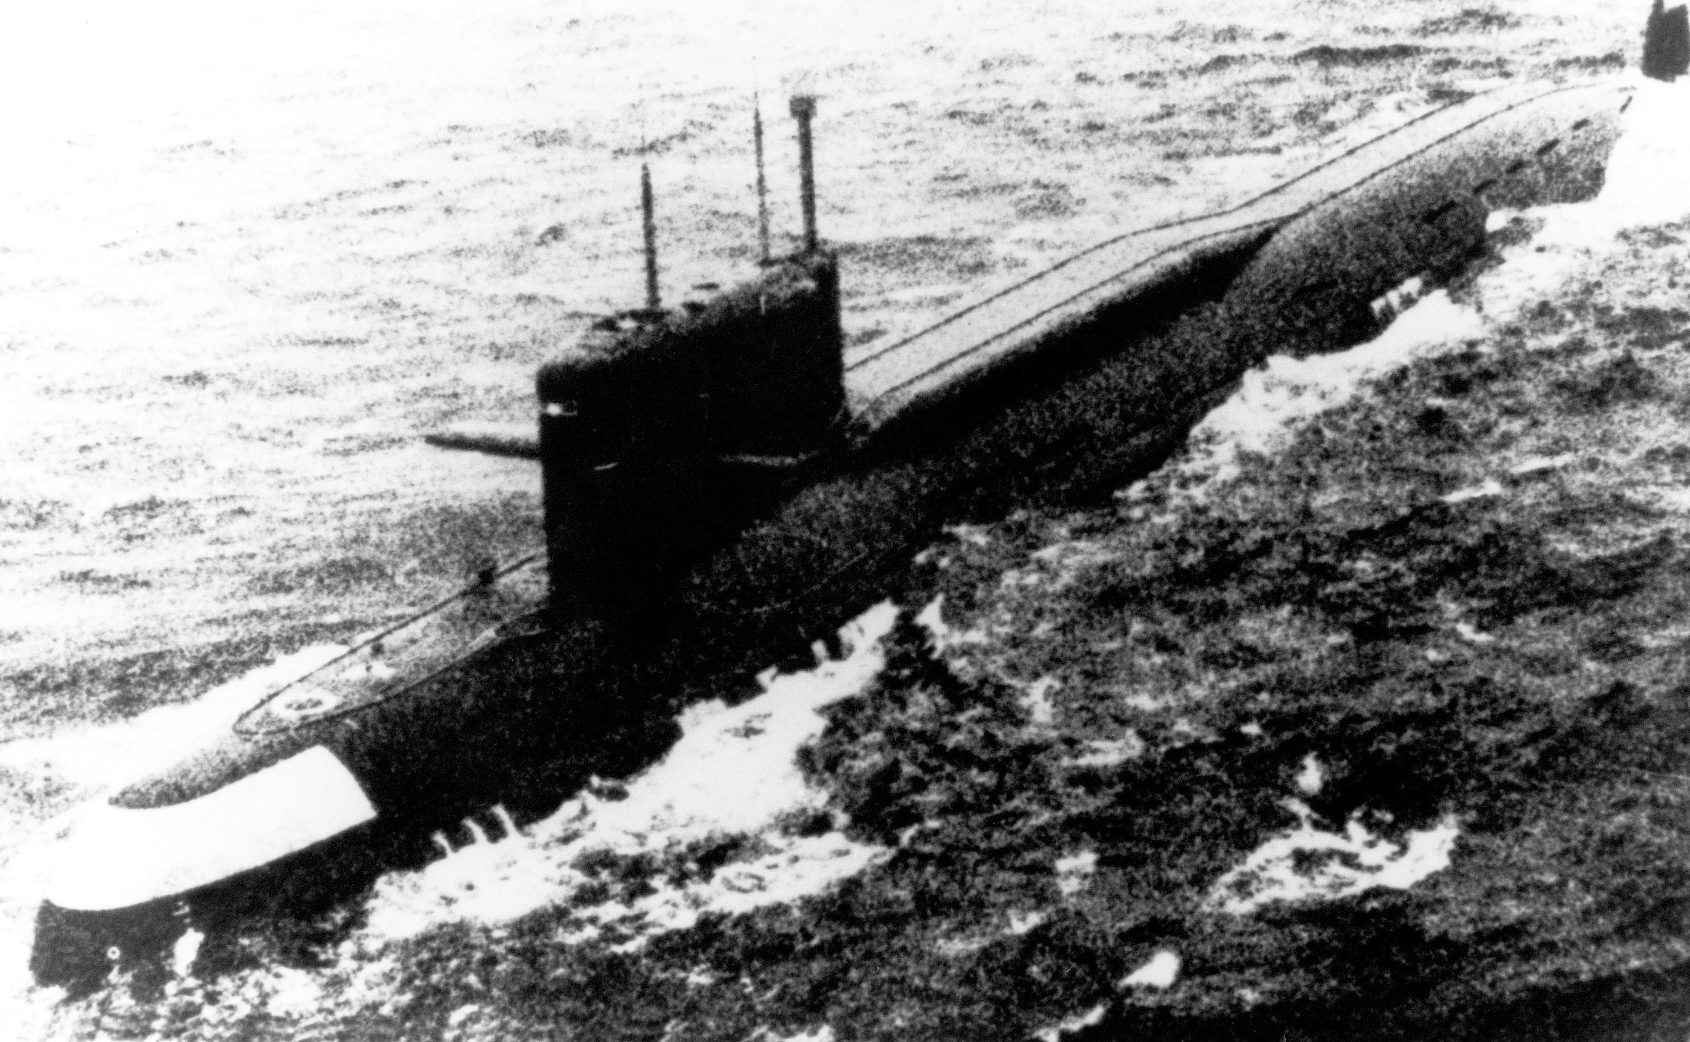
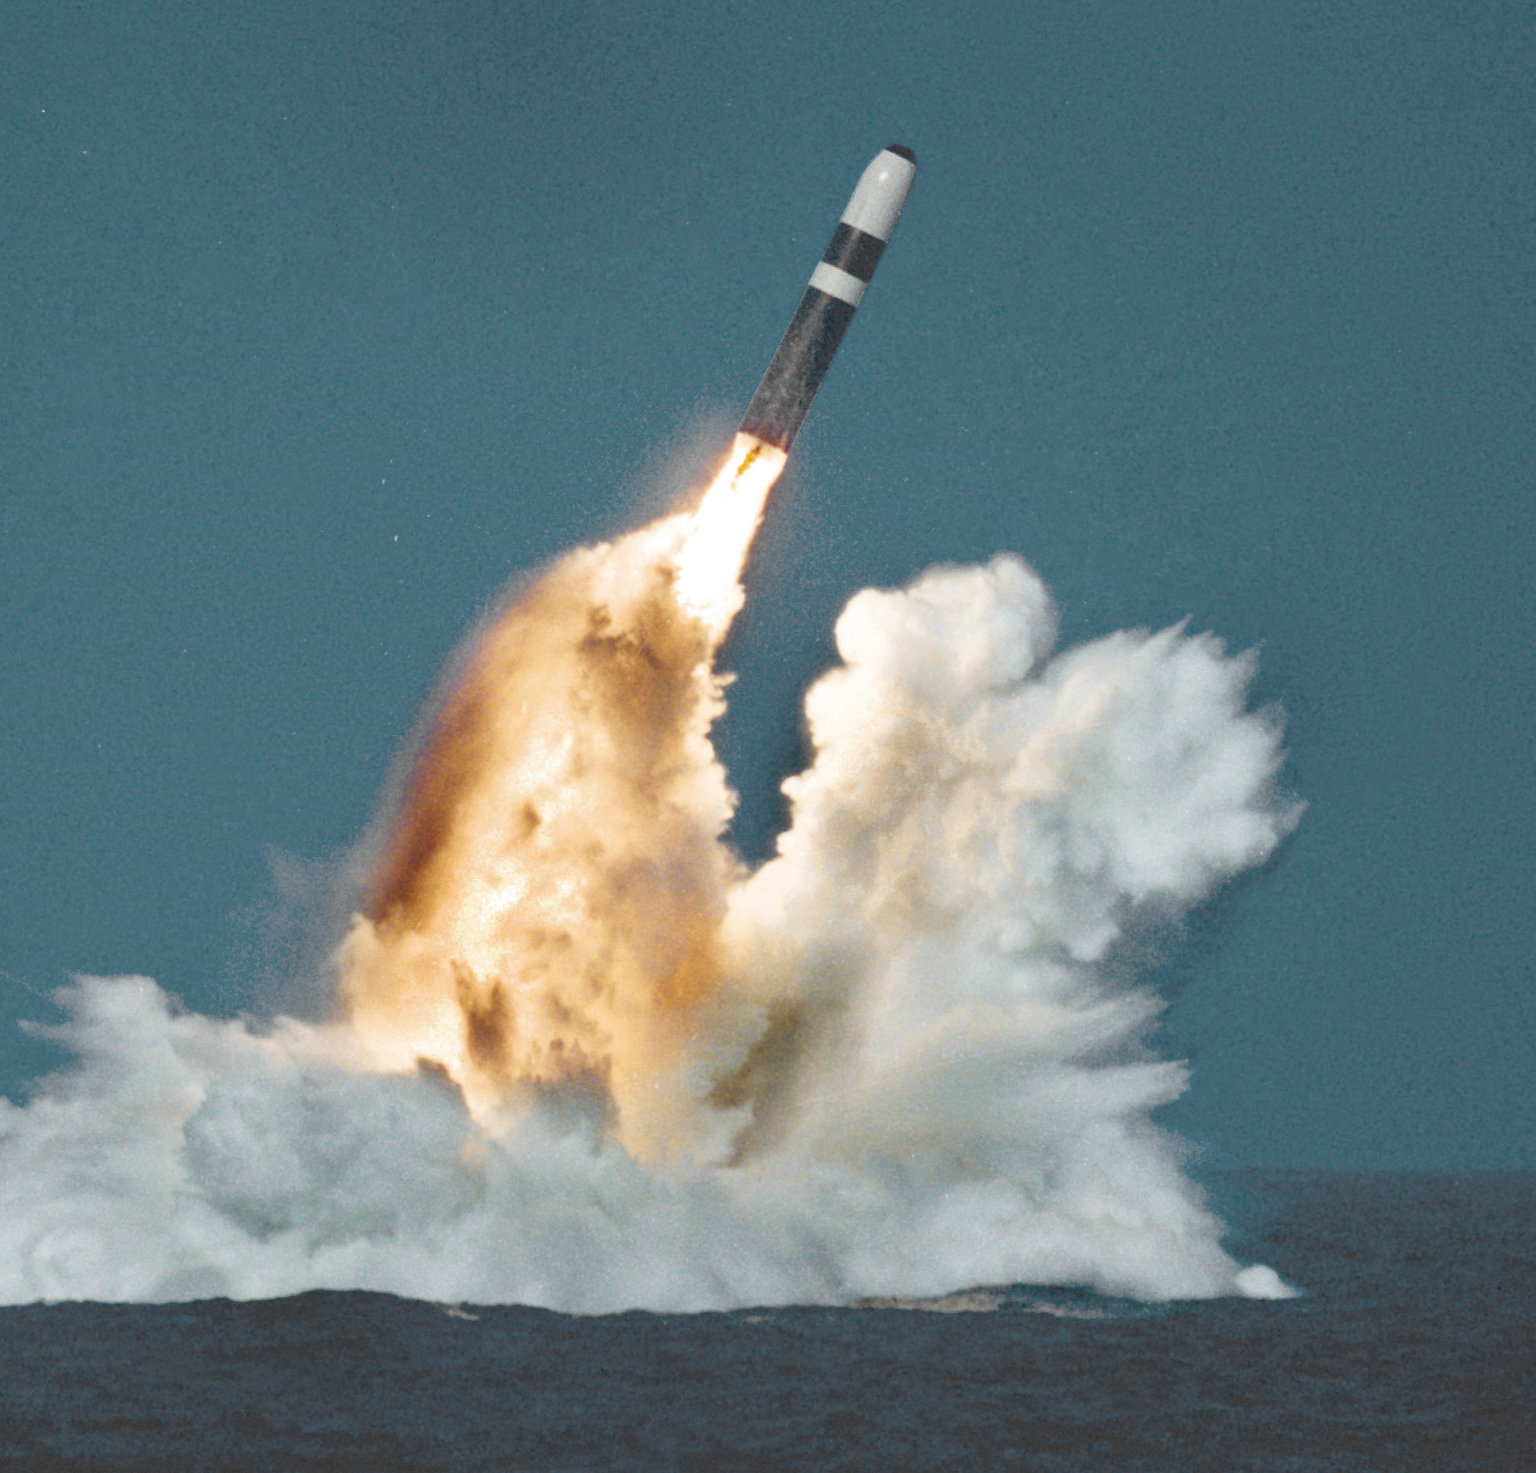
Soviet Echo Class
Soviet Golf Class
Soviet Yankee Class
In the late 1950s, the increasing range capability of missiles launched from Soviet submarines posed a significant and growing threat to the US mainland and other US interests around the globe.

Slide 3
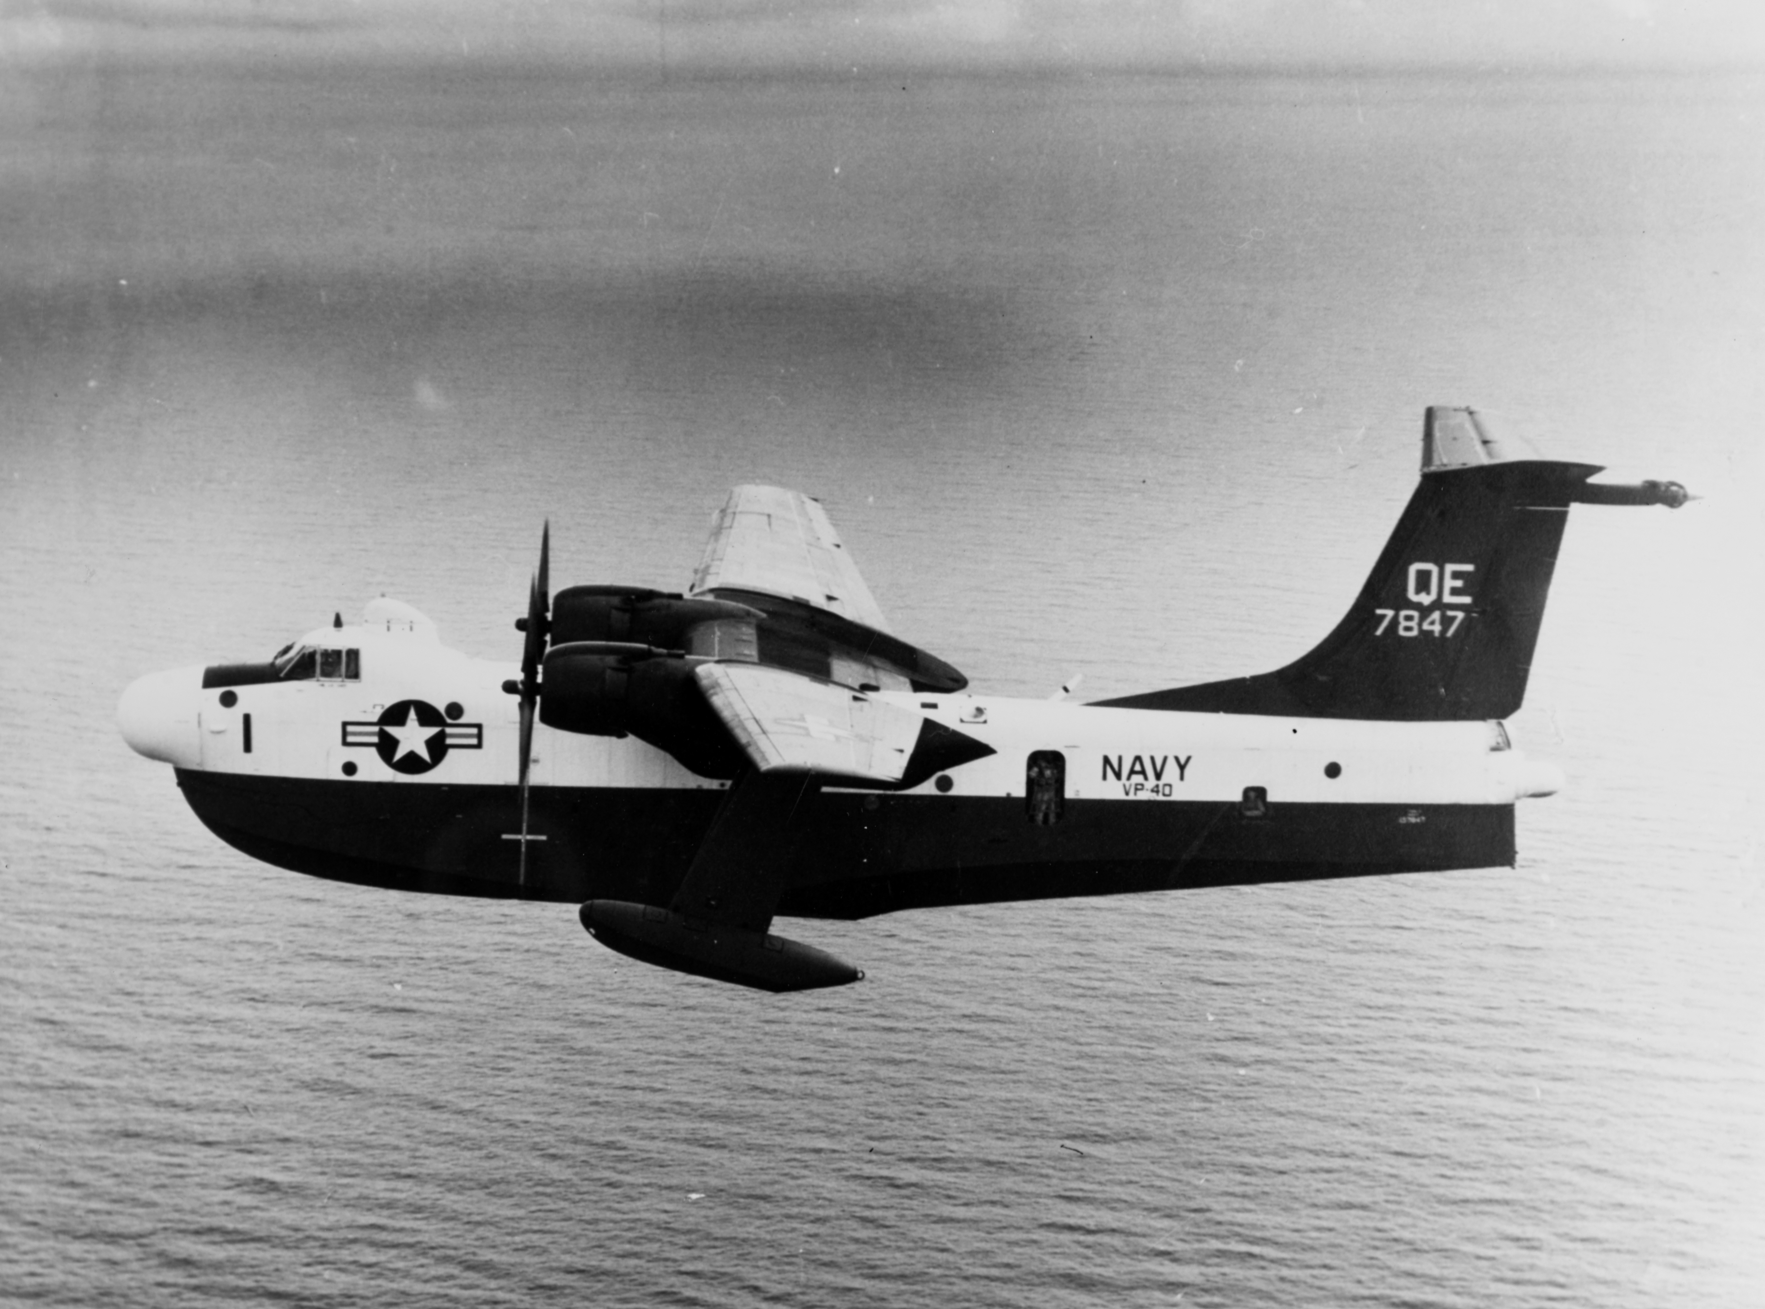
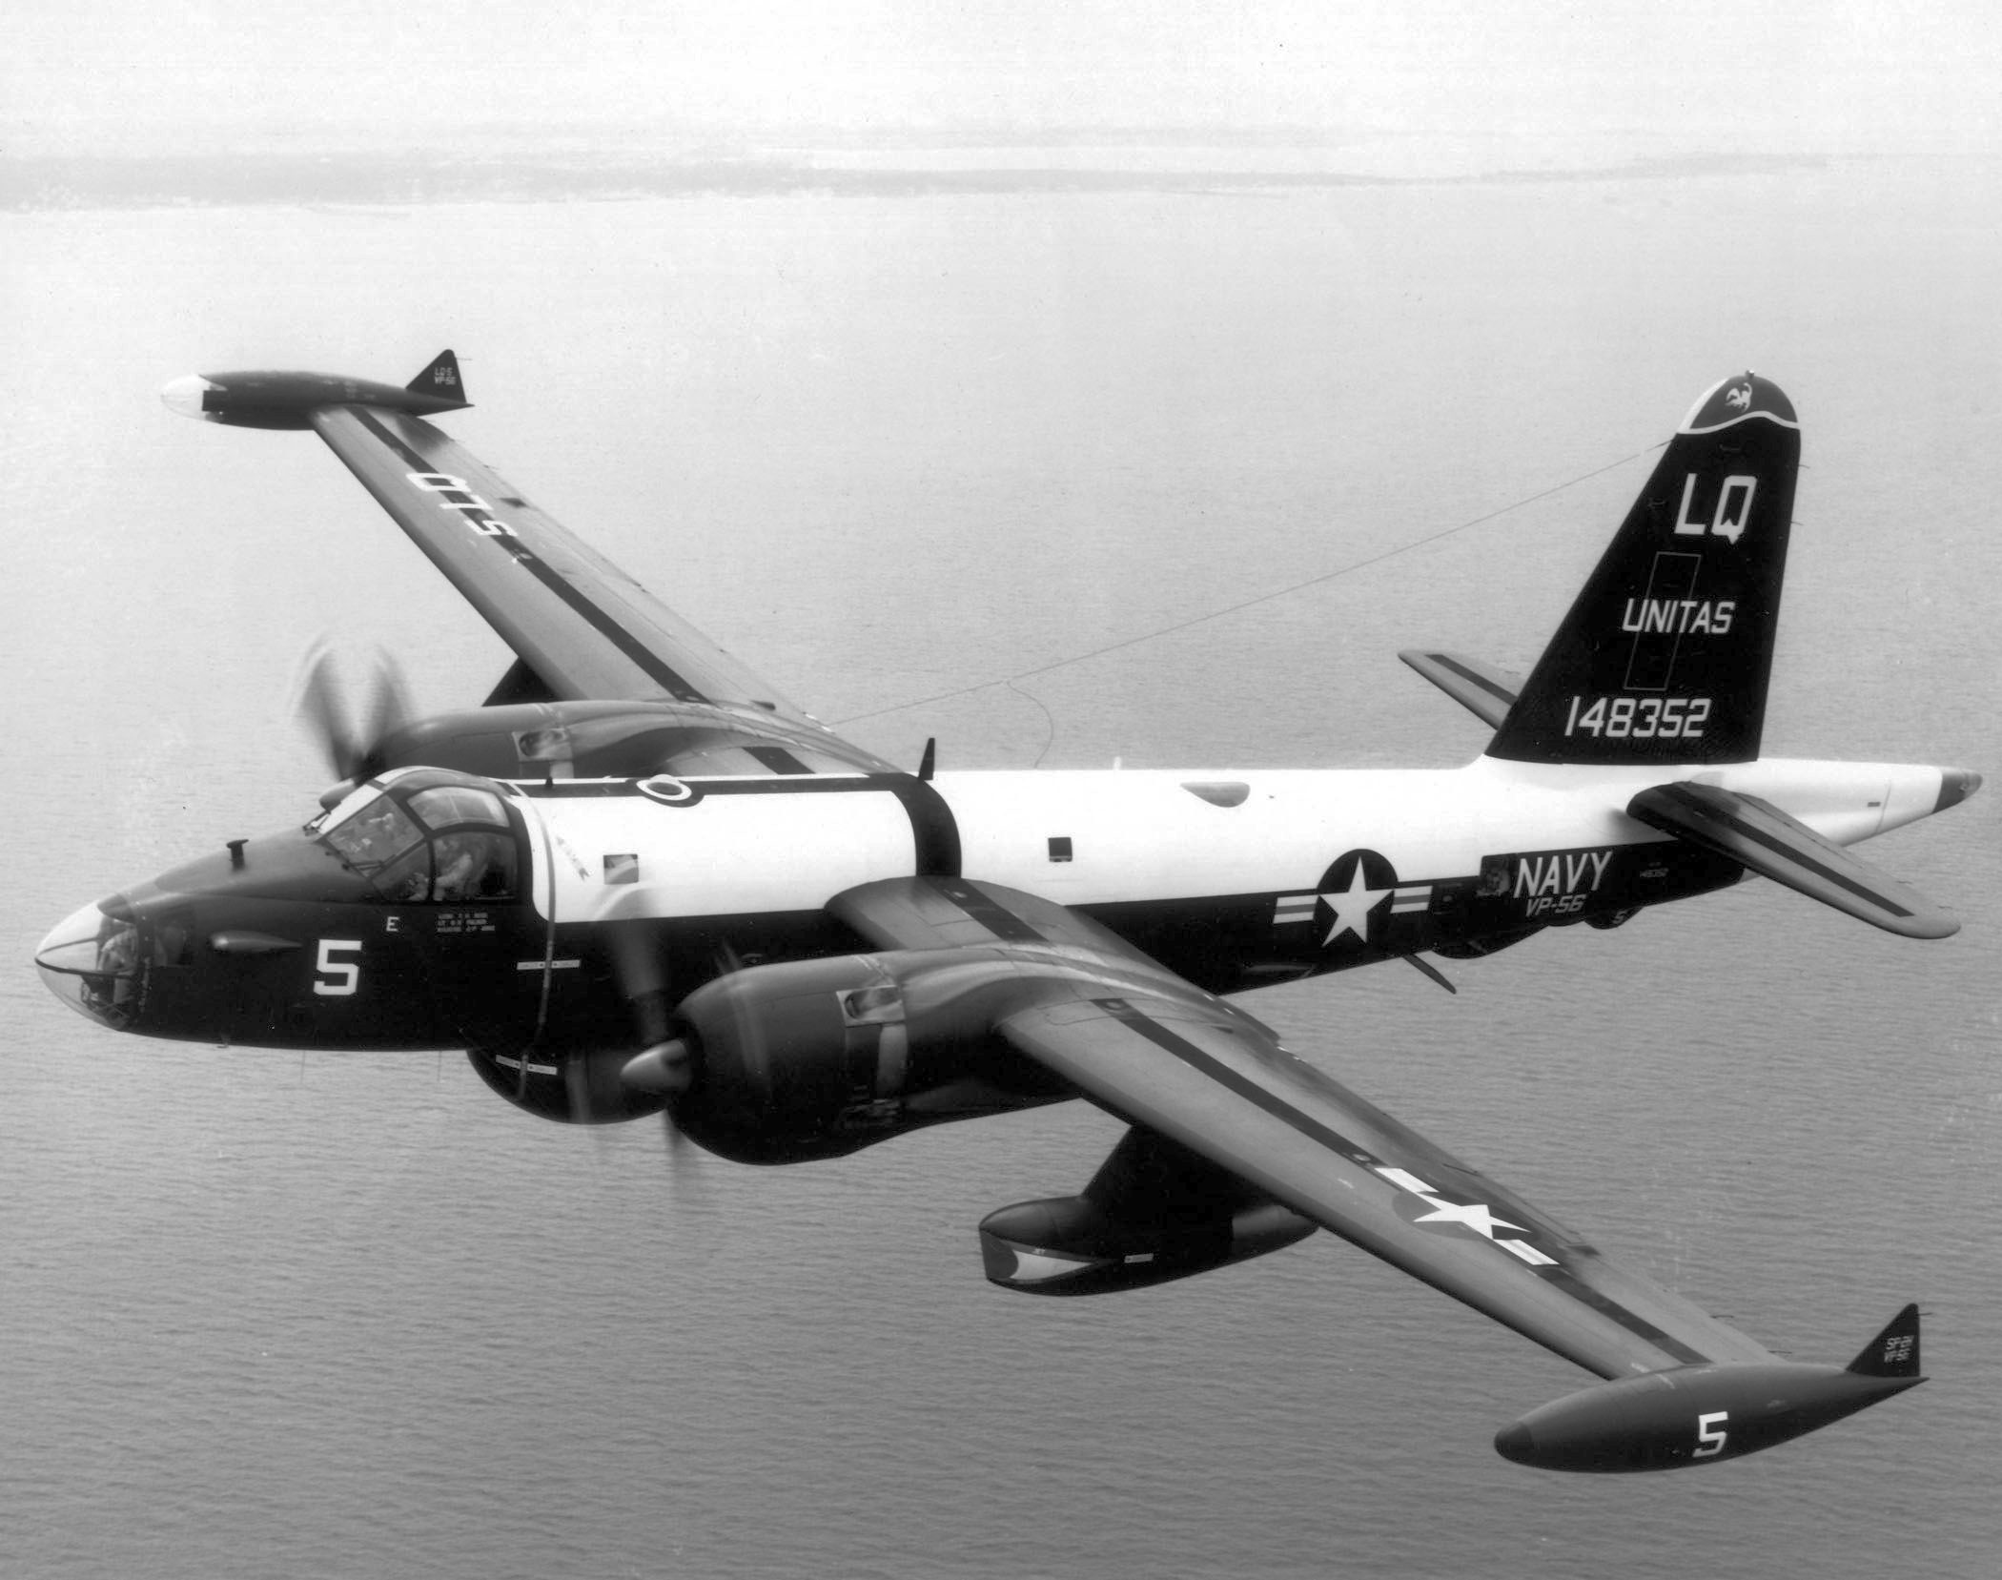
Martin P-5M
Lockheed P-2V
The US Navy needed much greater range, endurance, and pressurized all-weather capability over its aging piston-engined Anti Submarine Warfare (ASW) aircraft, then comprised of the P-5M flying boat and P-2V land aircraft.

Slide 4
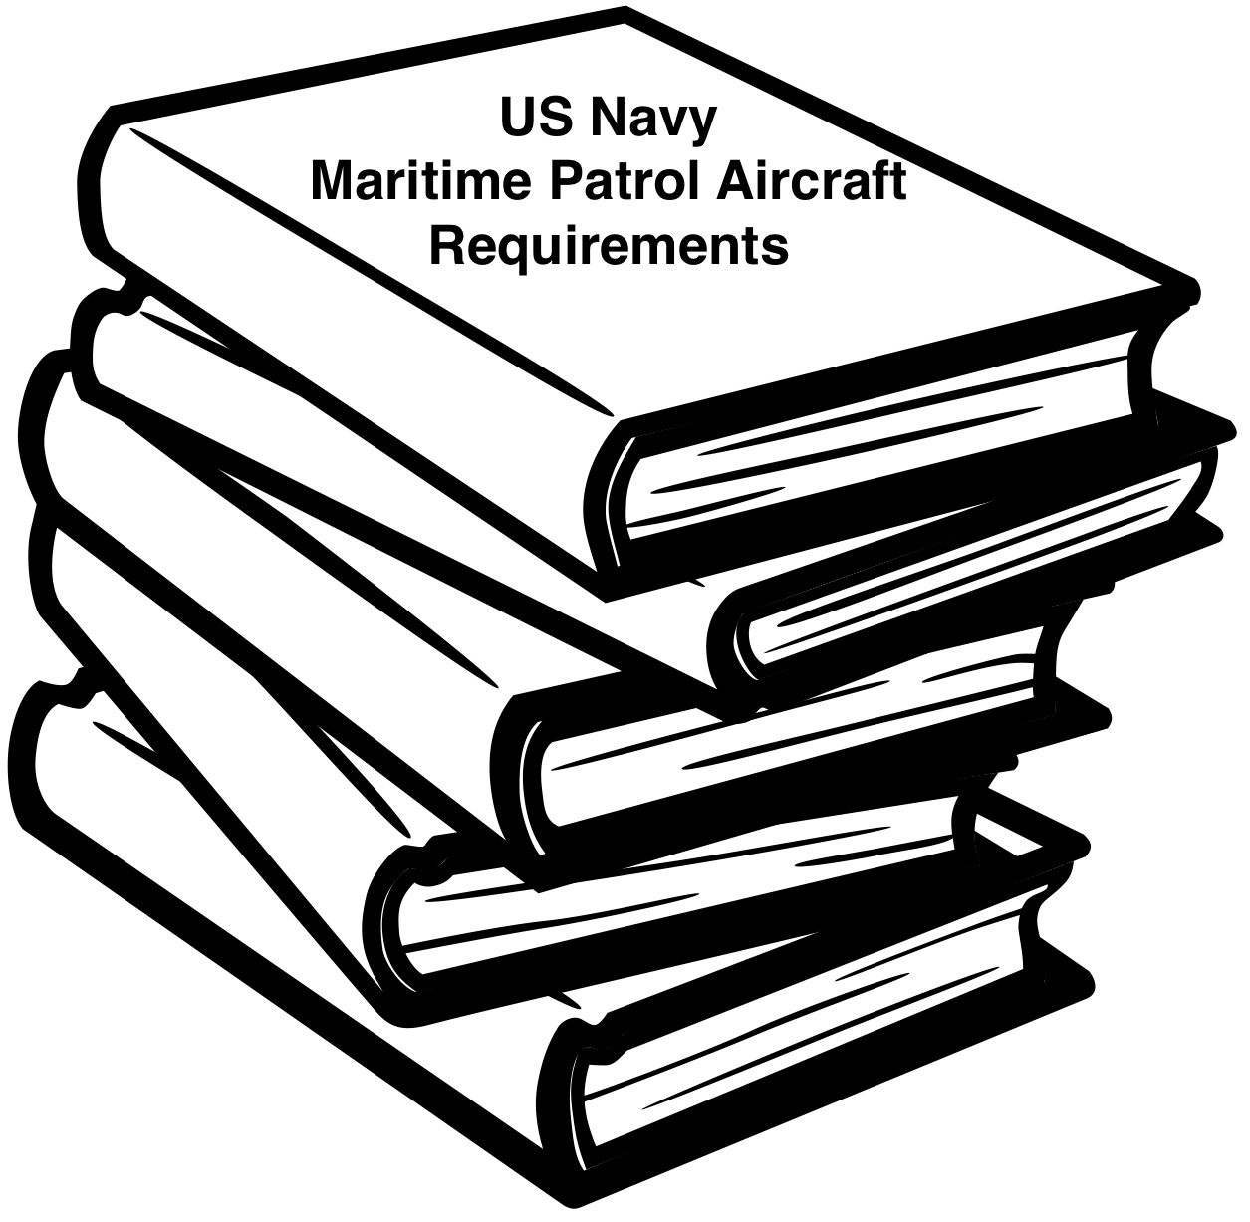
This led the Navy to establish requirements for a new land-based, multi-mission maritime patrol aircraft. Budget and schedule expediency required that an off-the-shelf airframe be adapted.

Slide 5
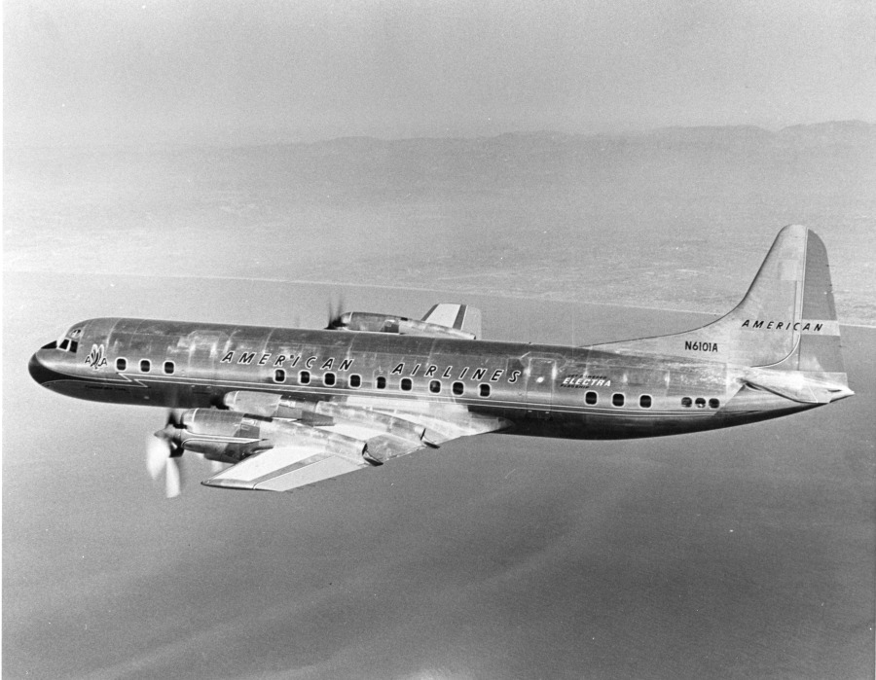
Lockheed proposed modifying its turboprop Electra airliner, and won the competition.

Slide 6
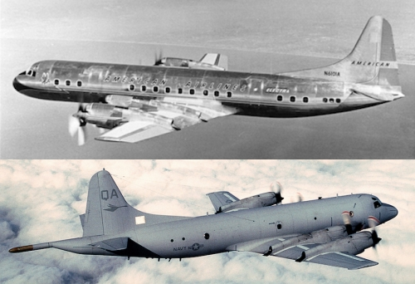
The most obvious changes to the Lockheed Electra to create the Navy’s P-3 Orion were:

Slide 7
…removal of nine feet of fuselage in front of the wing,…

Slide 8
…a reshaped nose for the Orion’s forward radar,…

Slide 9
…and a reshaped tail for the aft radar and magnetic sensor.

Slide 10
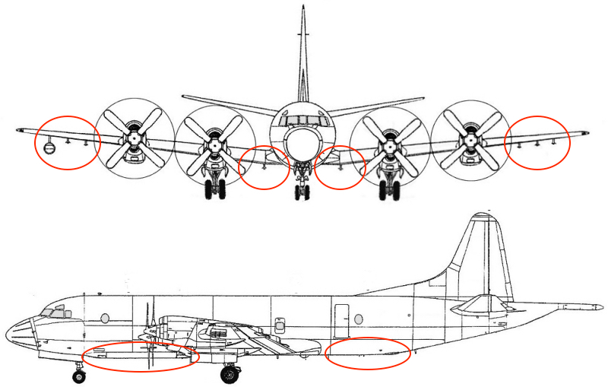
Bomb Bay
Internals Launch Tubes
Other changes included ordnance points under the wings, an enclosed bomb-bay, and tubes to launch internal stores.

Slide 11
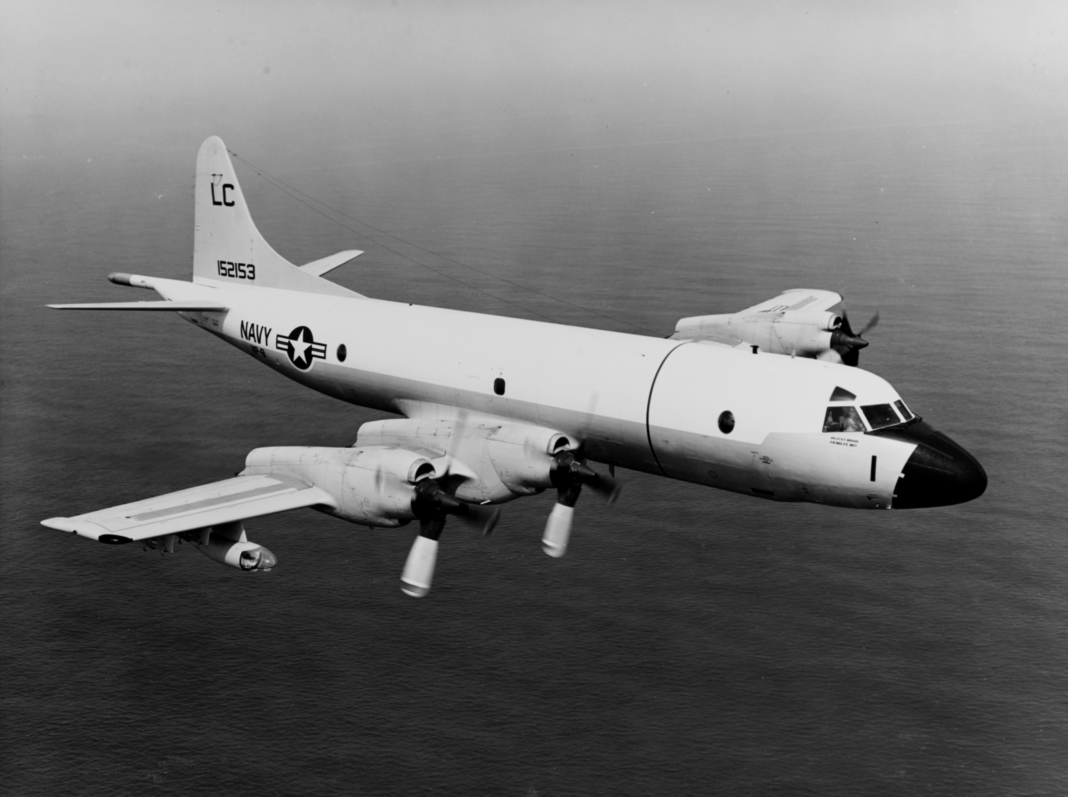
The wing hard points also provided attachment for mission aids and sensors, such as searchlight, low-light TV camera, ESM pod, and infrared camera.

Slide 12
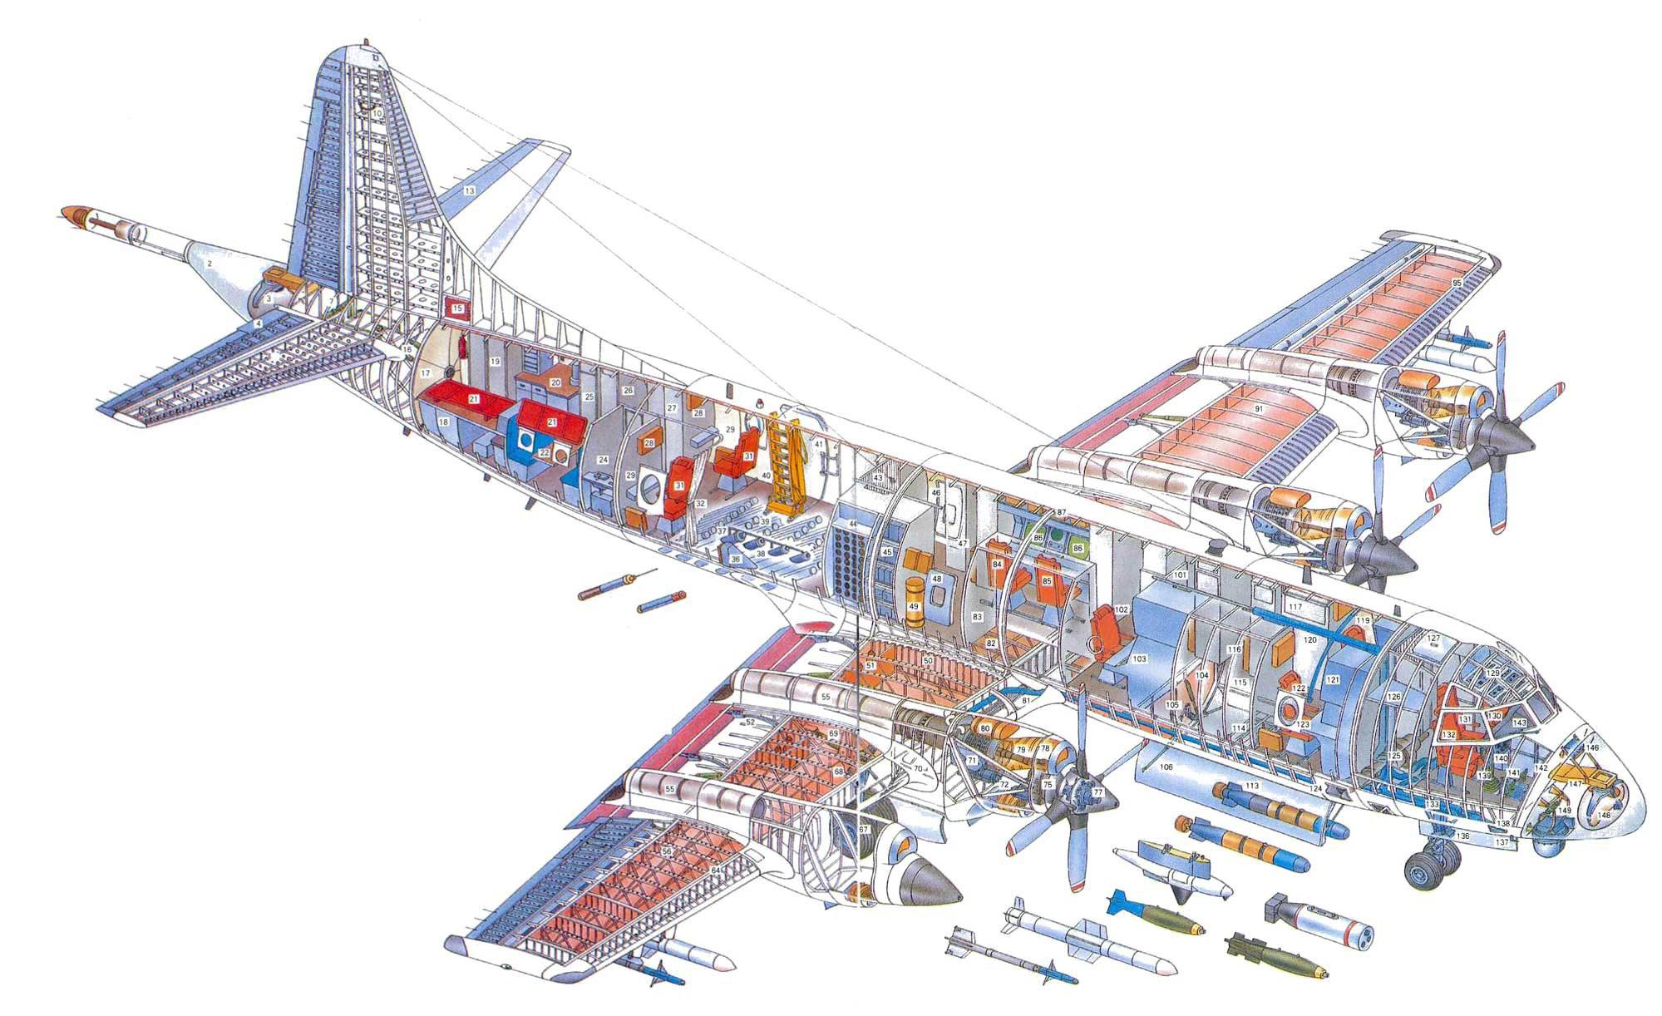
The former passenger cabin became filled with tactical crew stations and electronic equipment bays.

Slide 13
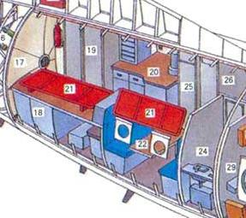
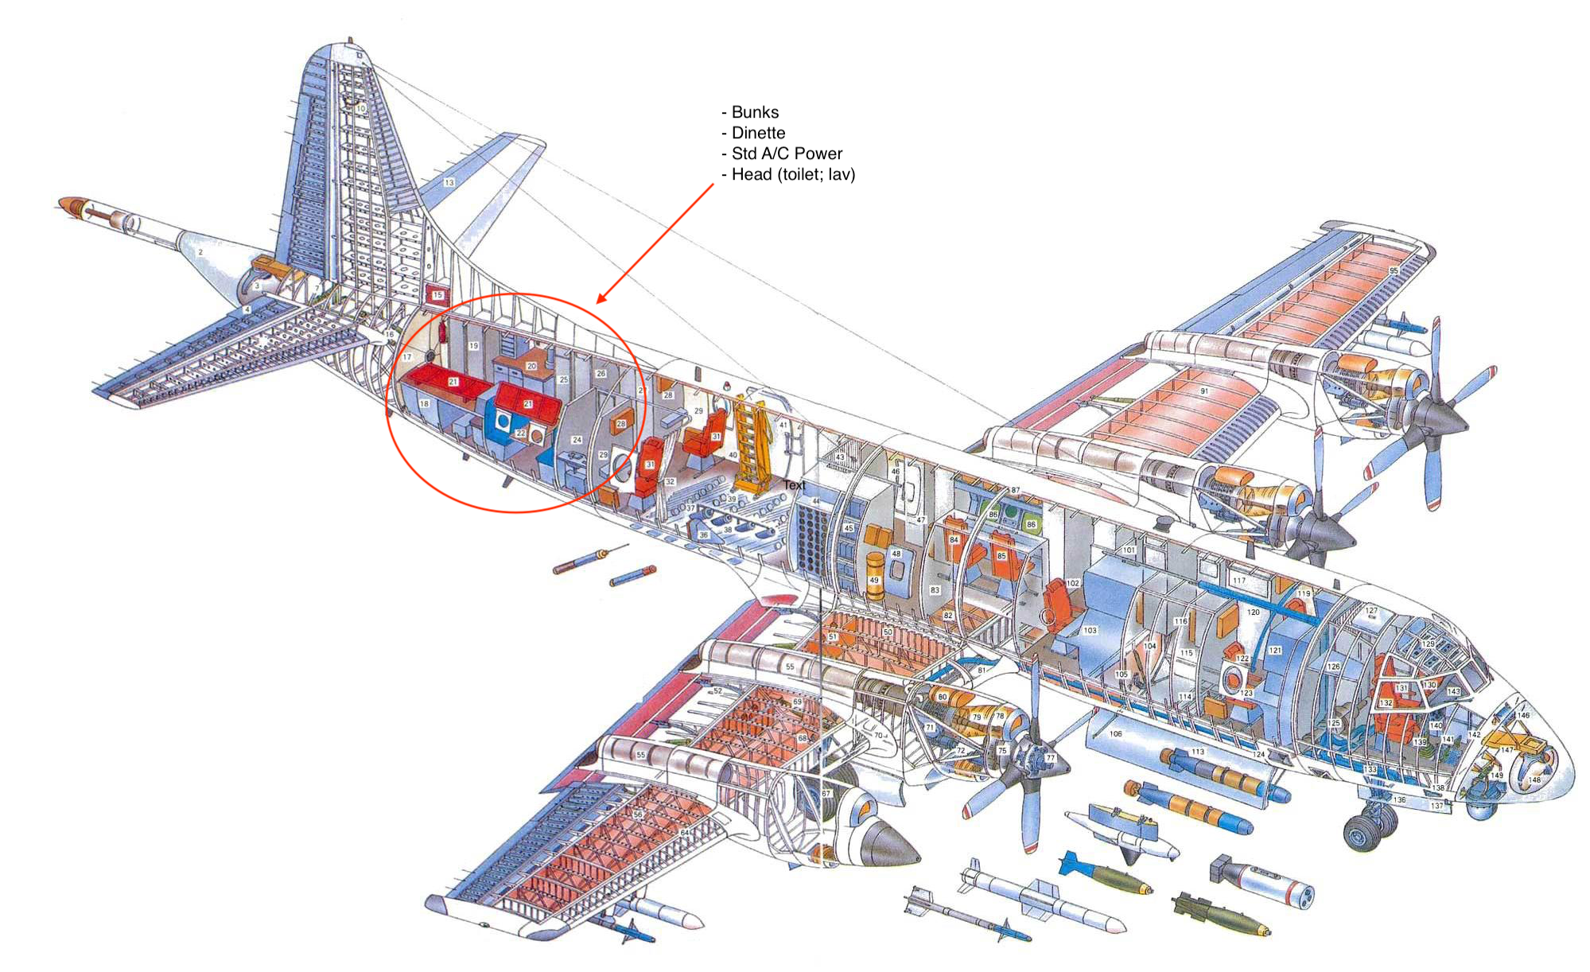
Long flight considerations included bunks, a refrigerator, 120 volt ac power, and even an oven.

Slide 14
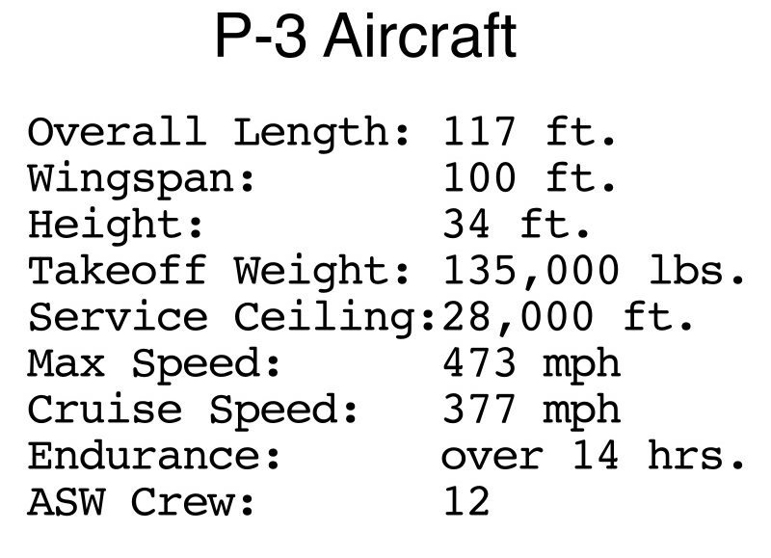
The basic specifications and performance of the P-3 are shown in this table.

Slide 15
The ASW crew of twelve was comprised of five officers and seven enlisted.

Slide 16
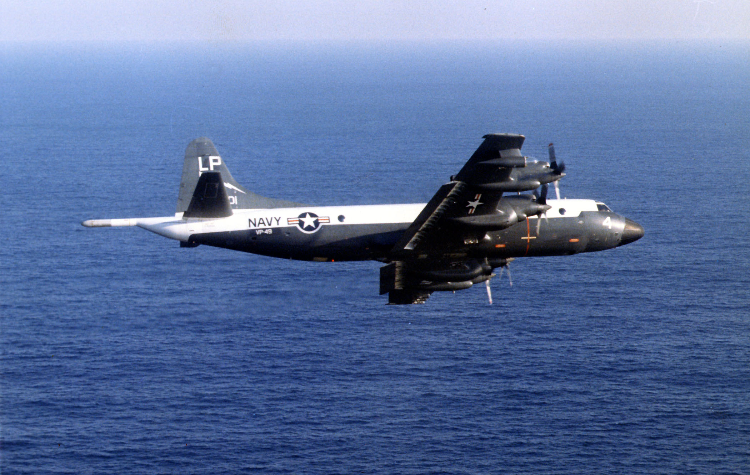
In 1962, the Lockheed P-3 A Orion became operational.

Slide 17
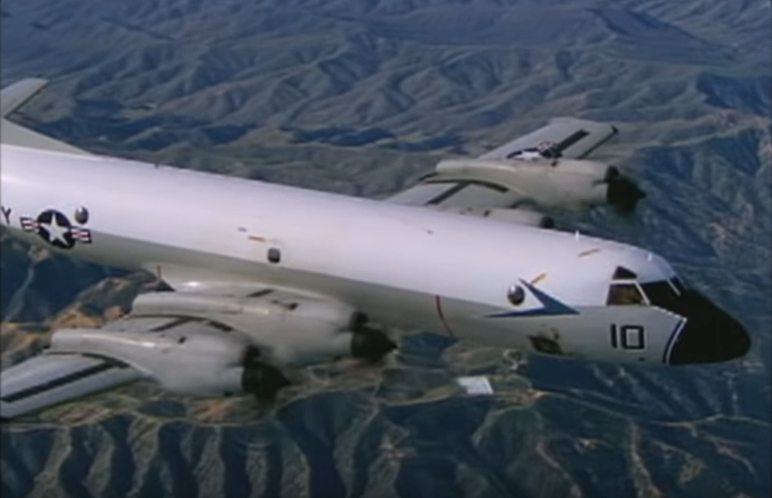
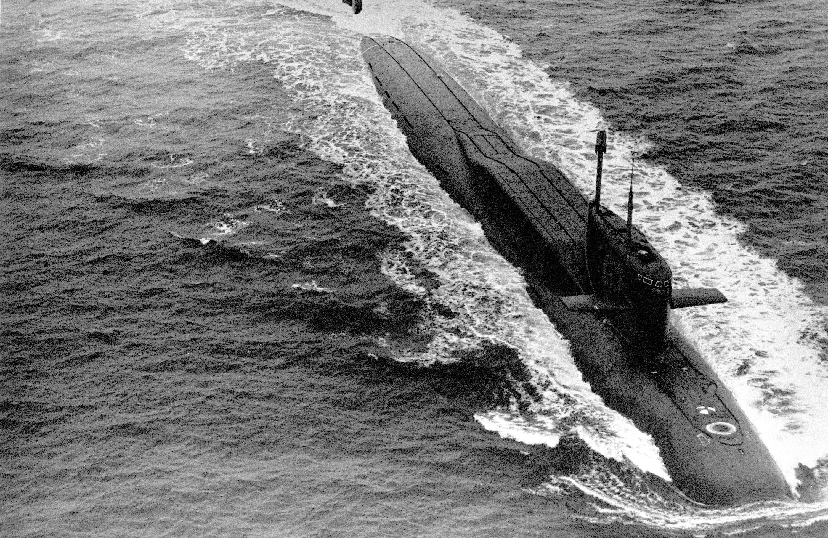
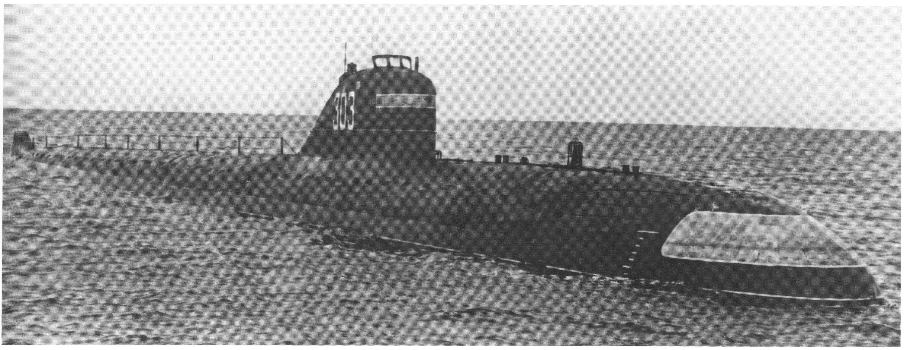
Soviet Yankee Class Ballistic Missile Submarine
Soviet November Class Fast Attack Submarine
The initial primary mission of the P-3 was to locate and track ballistic missile and fast attack submarines, and to attack and destroy if so directed.

Slide 18
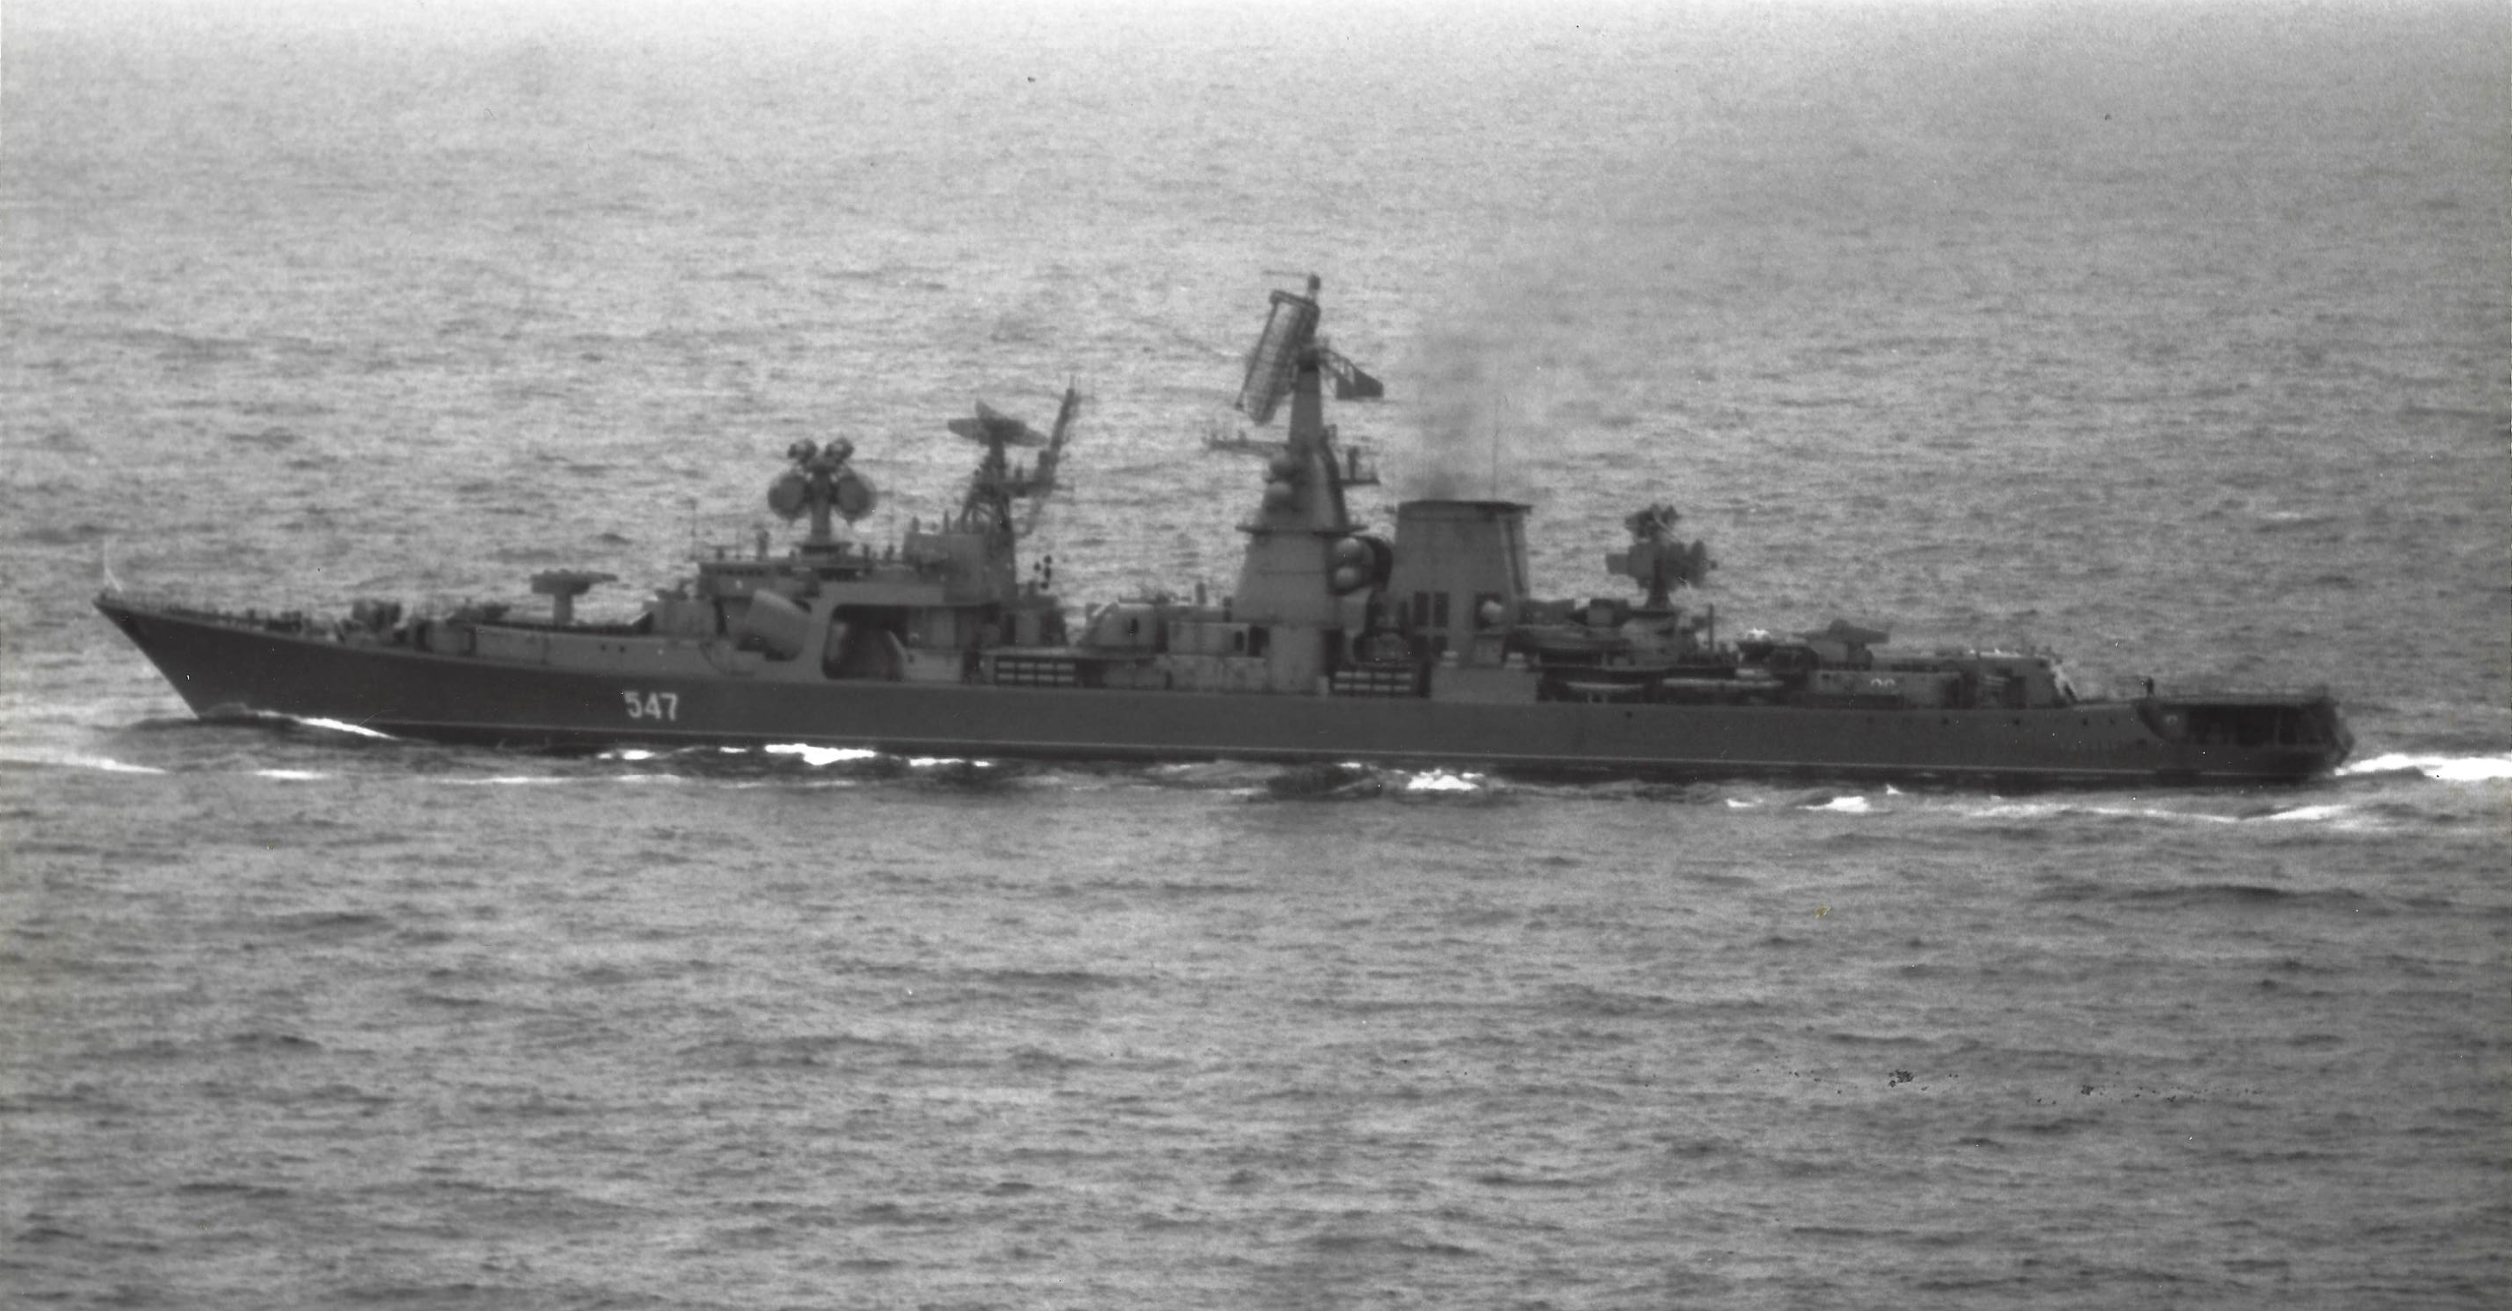
Additional missions included Anti-surface Warfare and maritime patrol reconnaissance and surveillance. Much later, after the end of the Cold War, other missions would be assigned.

Slide 19
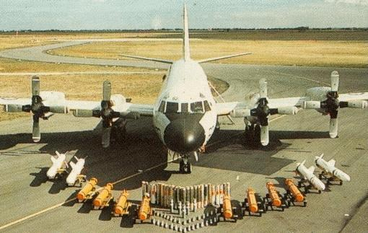
The P-3 could carry and launch several types of weapons oriented to its Anti-submarine and Anti-surface missions.

Slide 20
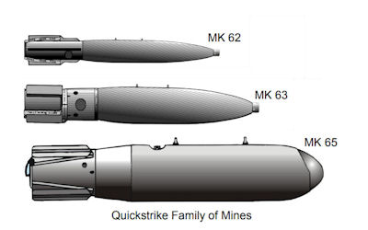
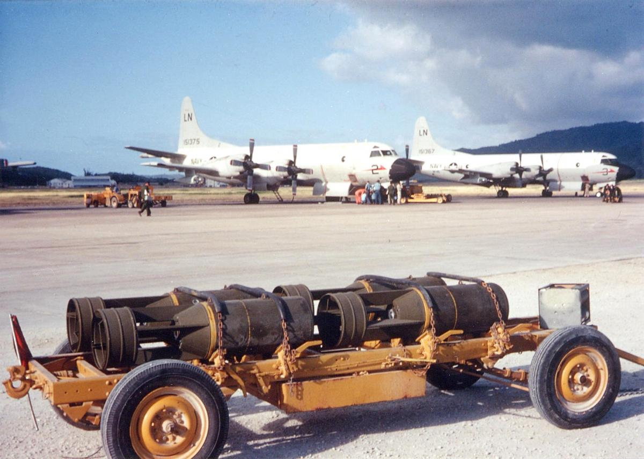
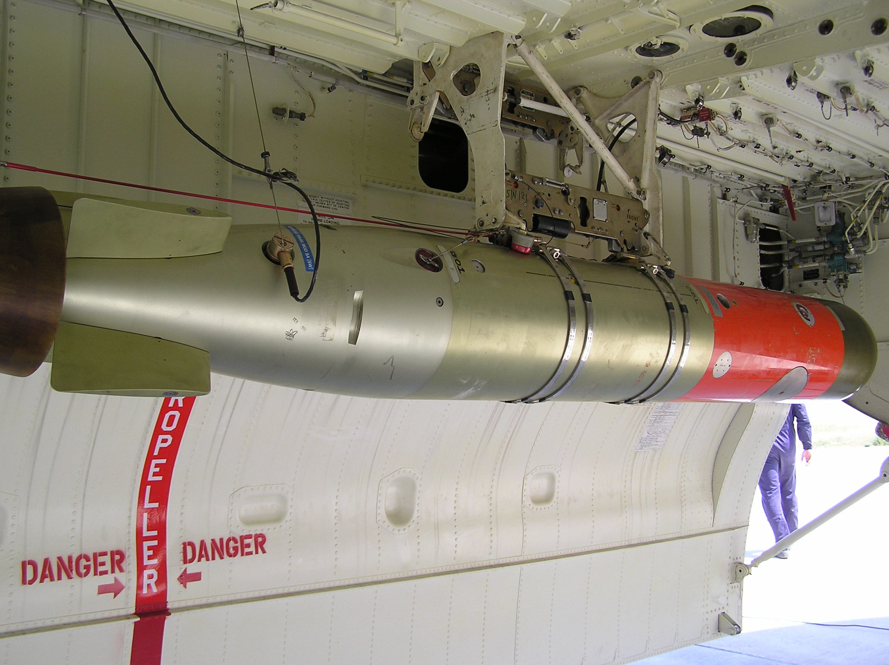
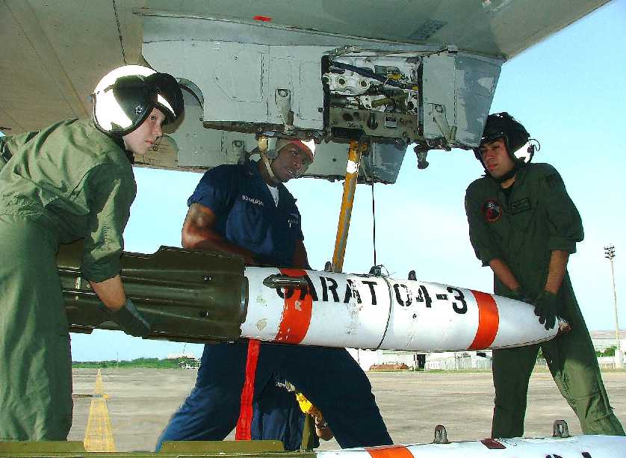
Mines (MK-62 shown)
Depth Bombs/Charges (MK-54 shown)
MK-46 Torpedo
Mines, Depth Bombs, and Torpedoes can be launched from the bomb bay or wing points.

Slide 21
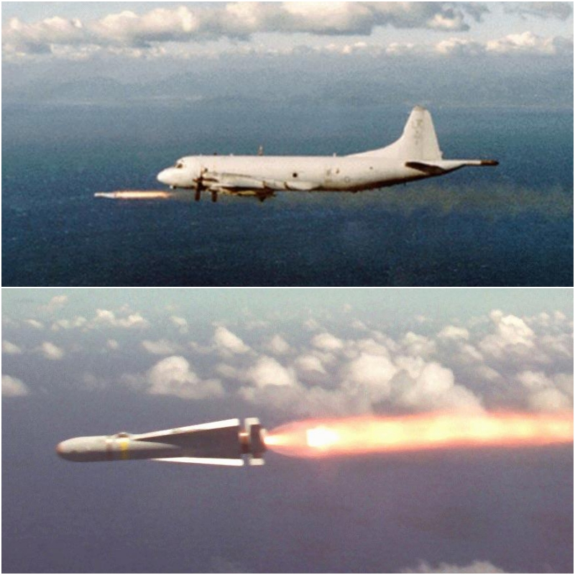
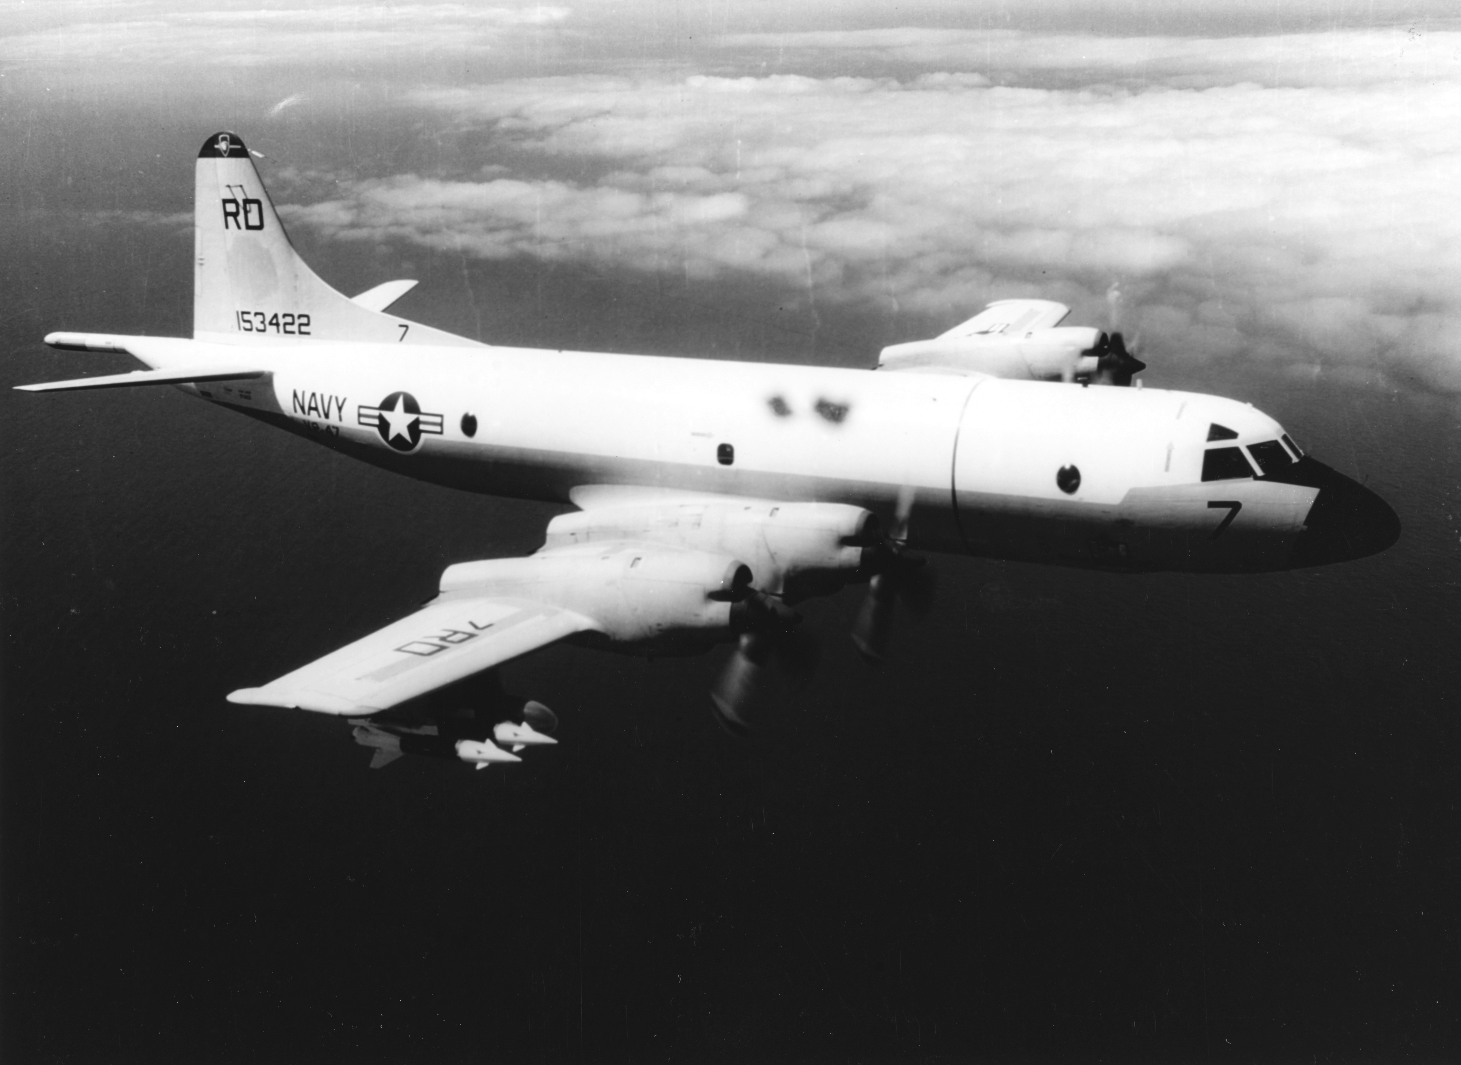
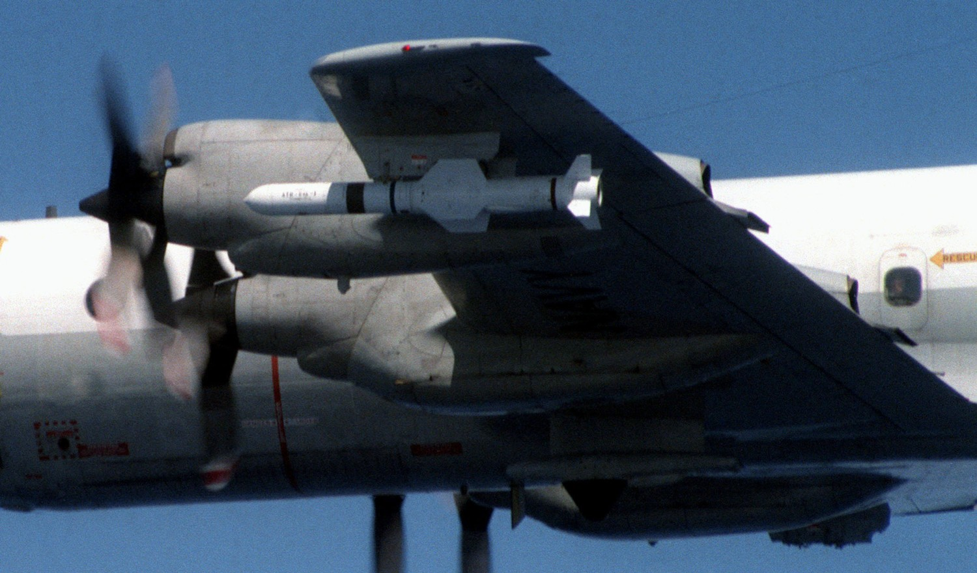
Bullpup
Maverick
Harpoon
An early air-to-surface missile was Bullpup, Later came Maverick and Harpoon.

Slide 22
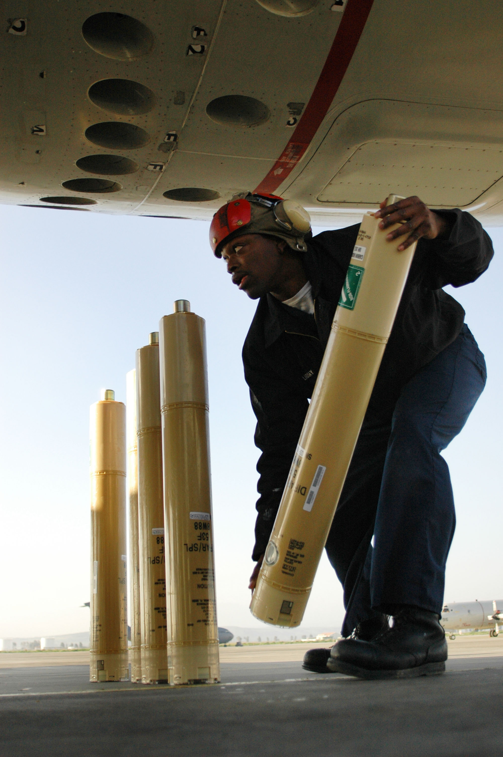
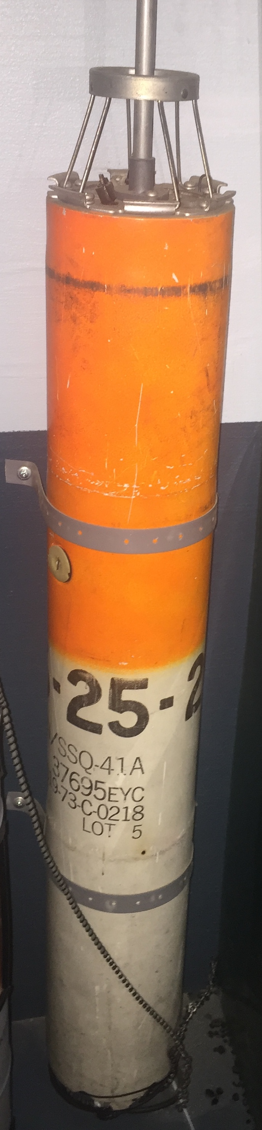
Sonobuoy launch tubes on (P-3C)
Sonobuoy
(SSQ-41)
Sonobuoy carry/launch sleeve
For sub-surface detection and tracking of submarines, it had specially designed tubes and mechanisms for launching a number of sonobuoys of several types.

Slide 23
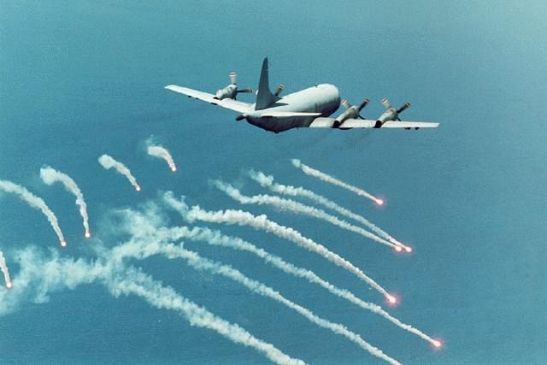
Later in its life, chaff and flare dispensers were incorporated for self defense.

Slide 24
A description of the P-3 would be remiss without providing a quick discussion of the sonobuoy and why it is important in airborne ASW.

Slide 25
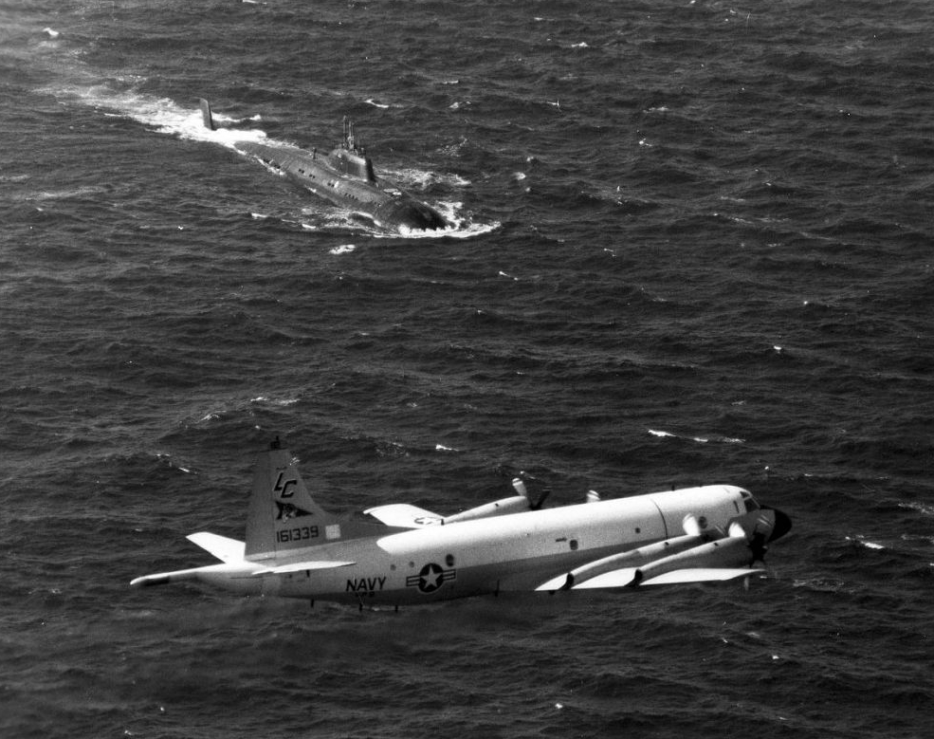
As noted earlier, one of the primary missions of the P-3 was Anti-Submarine Warfare (ASW).

Slide 26
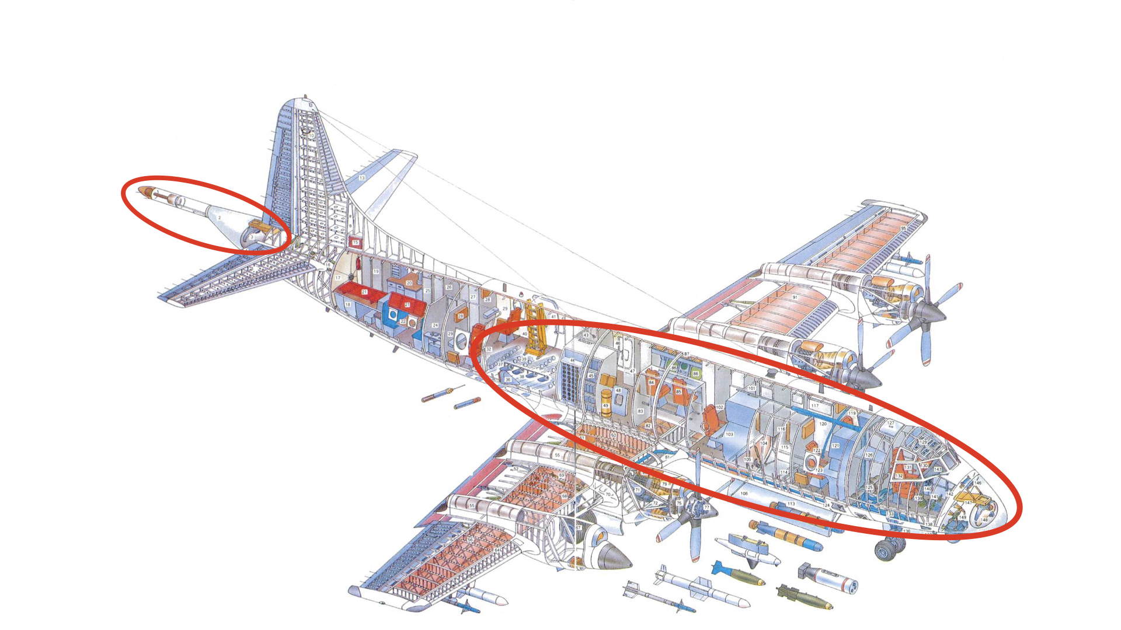
Indeed a large percentage of the mechanical, electronic, and display equipment on the P-3 was for finding and tracking submarines.

Slide 27
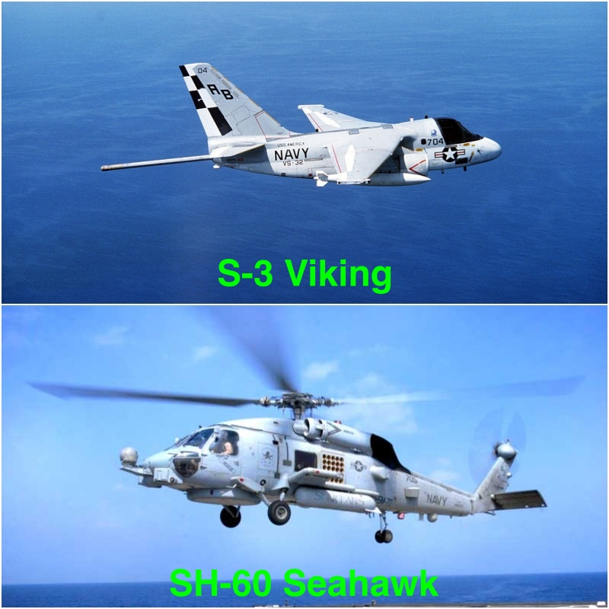
The same was true for other US Navy aircraft with an ASW mission. Without the sonobuoy, much of this equipment would be useless.

Slide 28
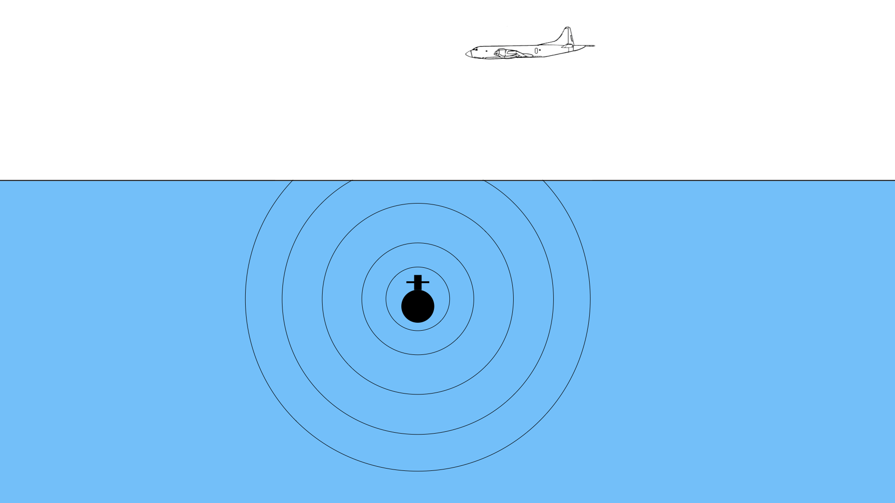
The primary method of finding a fully submerged submarine is detection of its sound transmissions in the water.

Slide 29
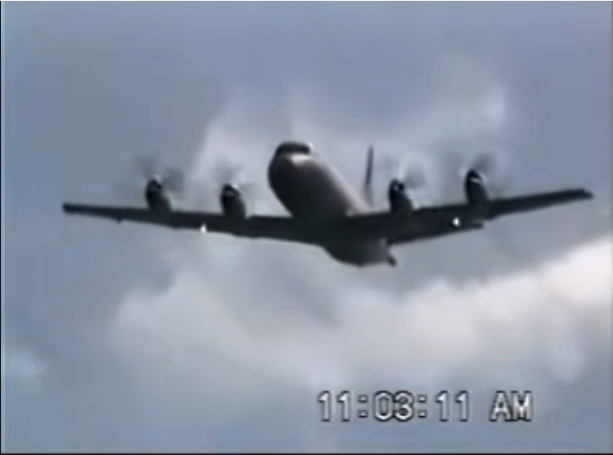
Since aircraft obviously cannot go underwater, a link is needed between the sounds in the water and the aircraft. The sonobuoy provides this link.

Slide 30
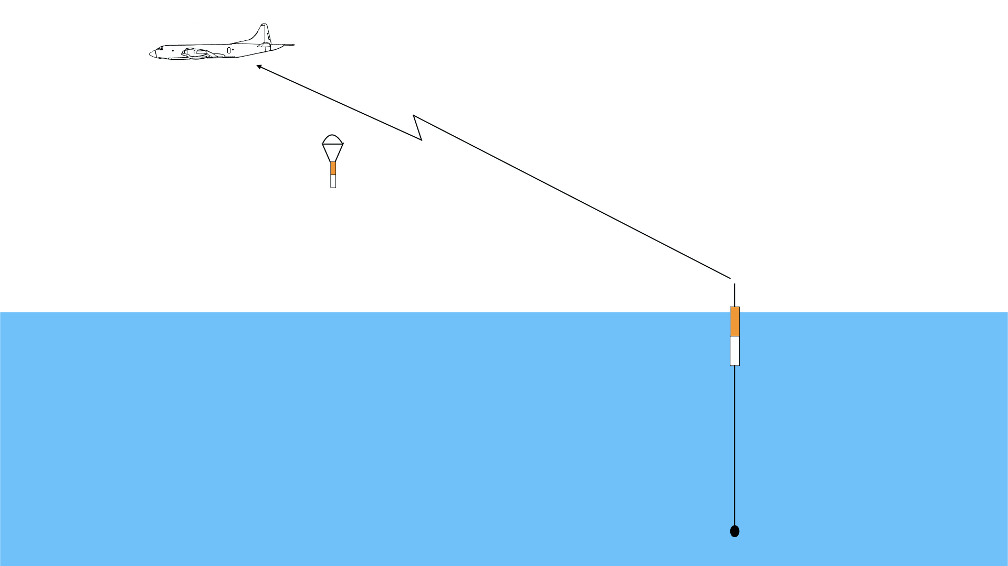
Each sonobuoy is basically a microphone connected to a radio transmitter via a very long flexible wire.

Slide 31
The transmitter and coiled up wire is housed in a long buoyant cylinder about 4 inches by 3 feet, making it easy to carry and launch by ASW aircraft.

Slide 32
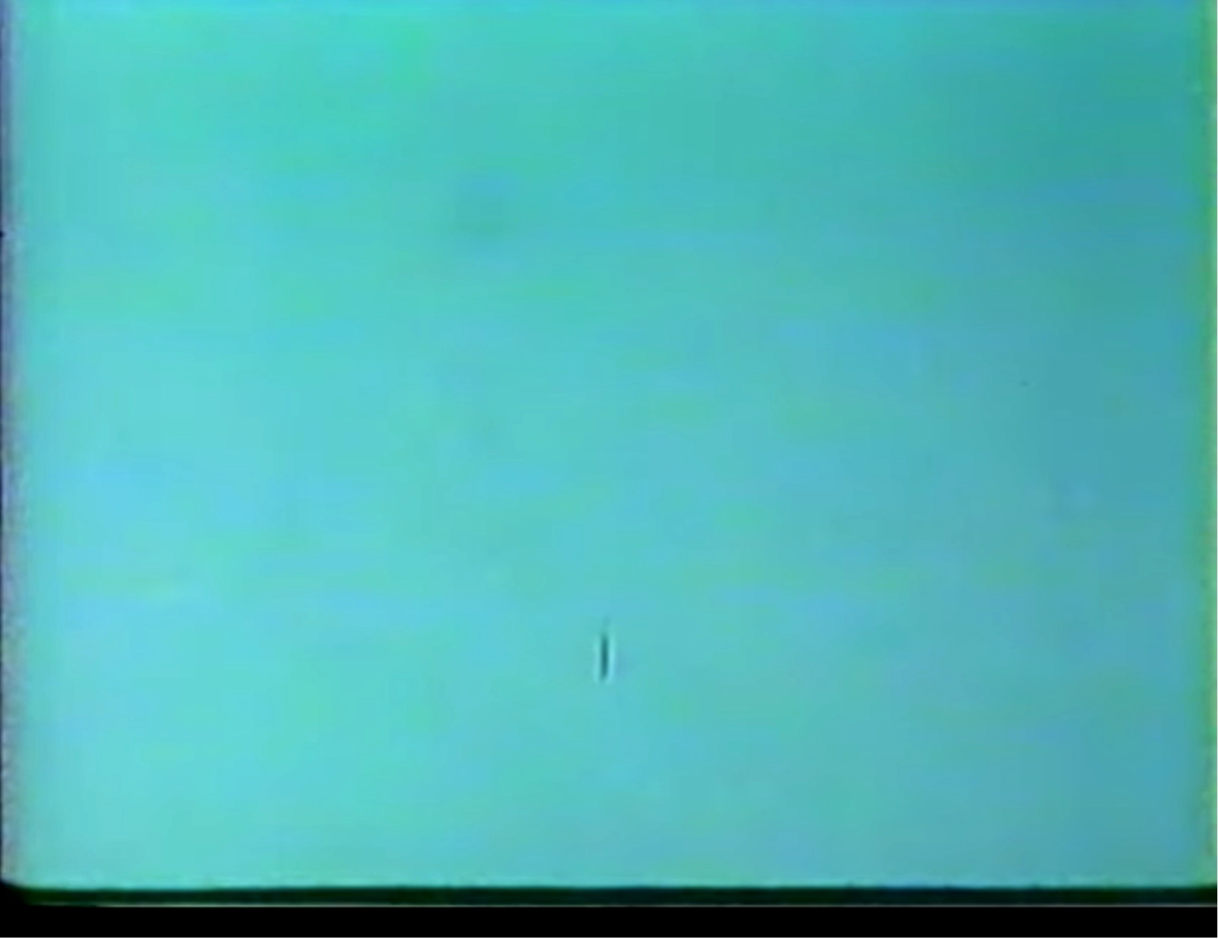
When the sonobuoy enters the water, its radio antenna is pushed upward and the microphone is reeled out below.

Slide 33
Underwater sounds striking the microphone are modulated onto radio signals and transmitted for reception by the aircraft.

Slide 34
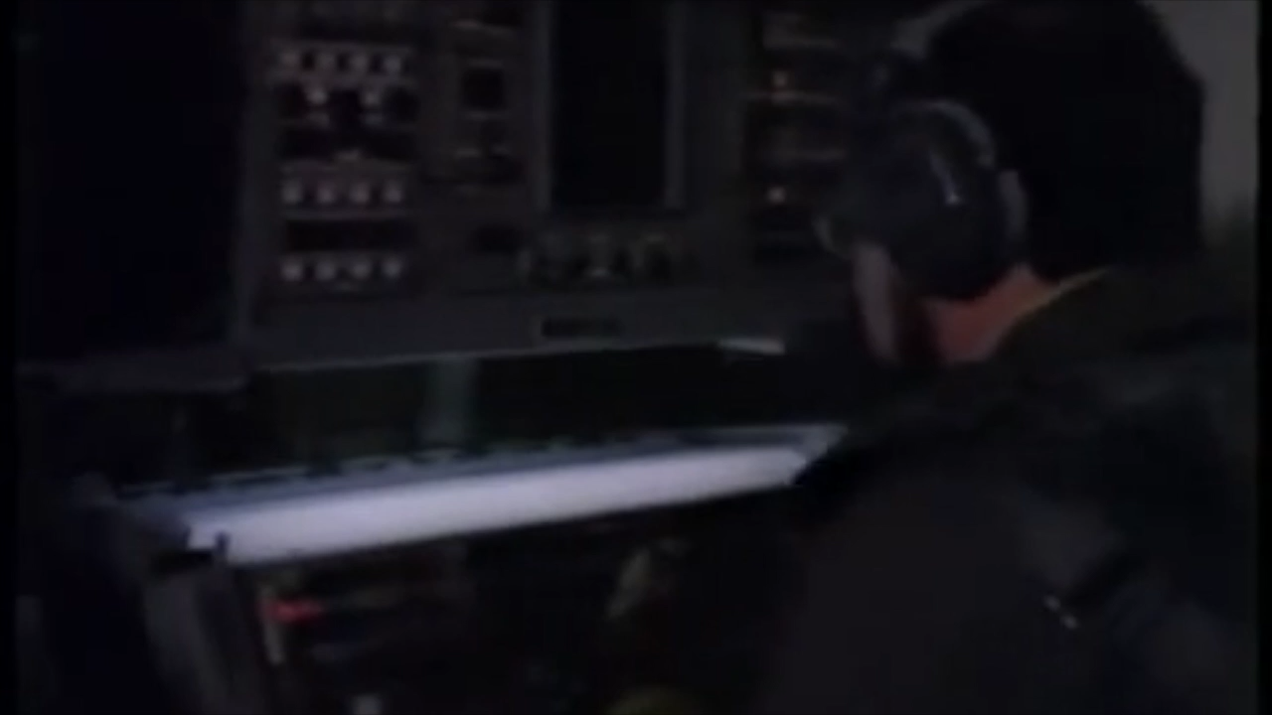
Electronics on the aircraft extract the microphone sounds and provide them to the acoustic sensor operators on both audio and video displays. The operators analyze these displays looking for a submarine target.

Slide 35
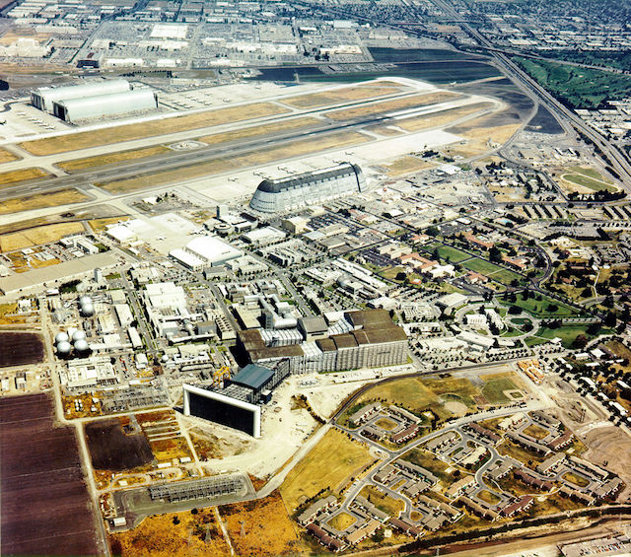
In 1963, Naval Air Station Moffett Field was designated the West Coast Center of operations for the P-3 Orion. This became Moffett Field’s business almost exclusively.

Slide 36
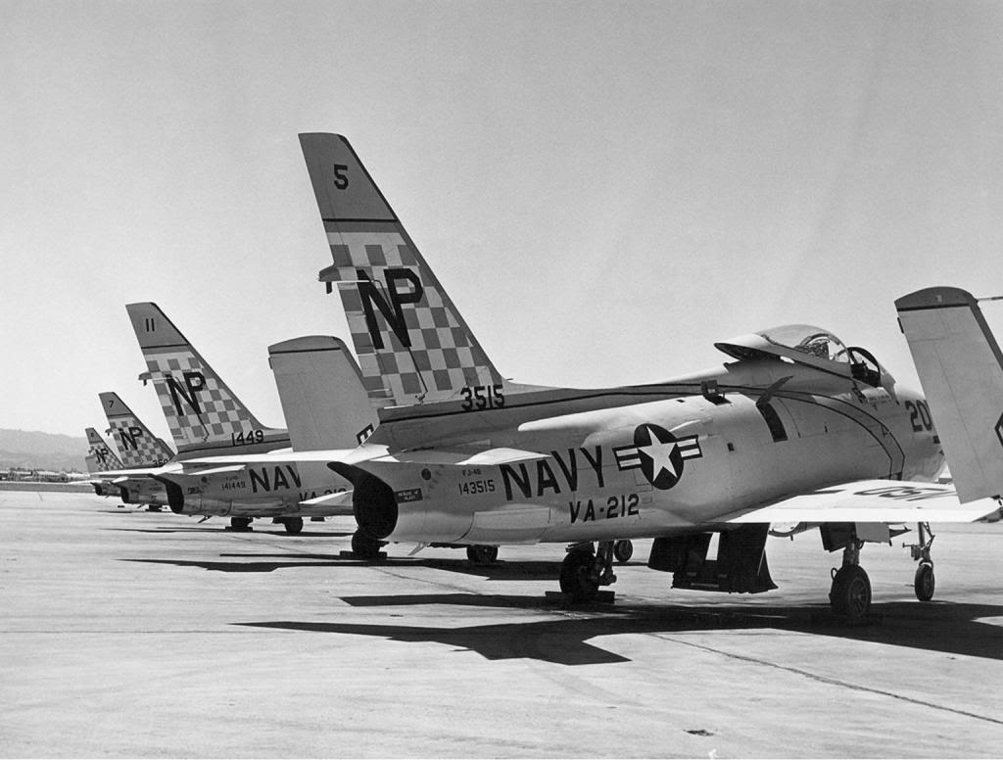
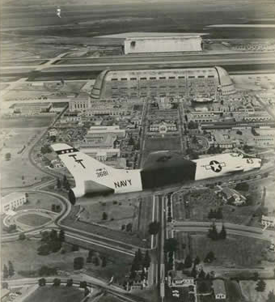
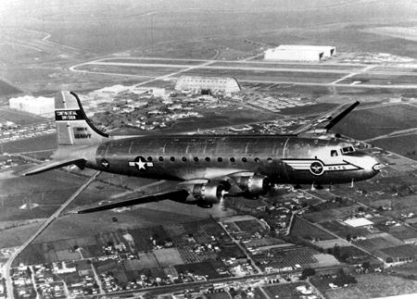
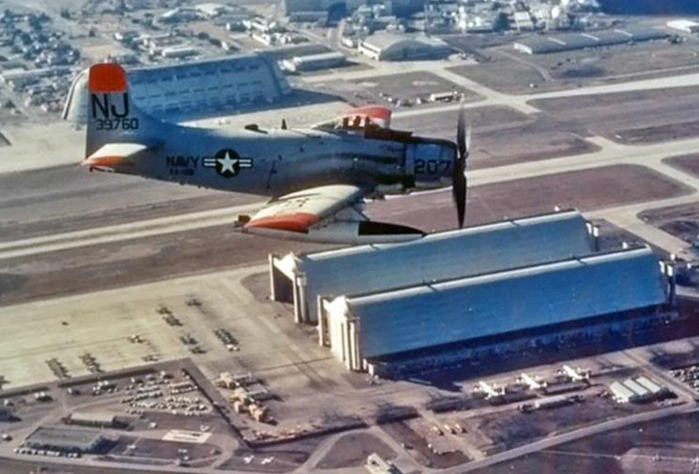
Units of other aircraft previously operating from Moffett, including carrier jets and Naval transport aircraft, were relocated to other bases.

Slide 37
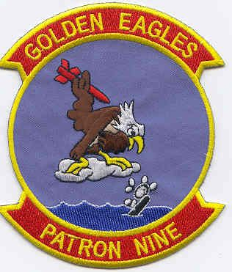
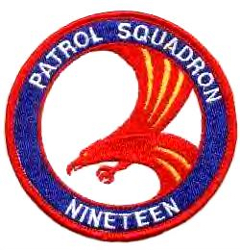
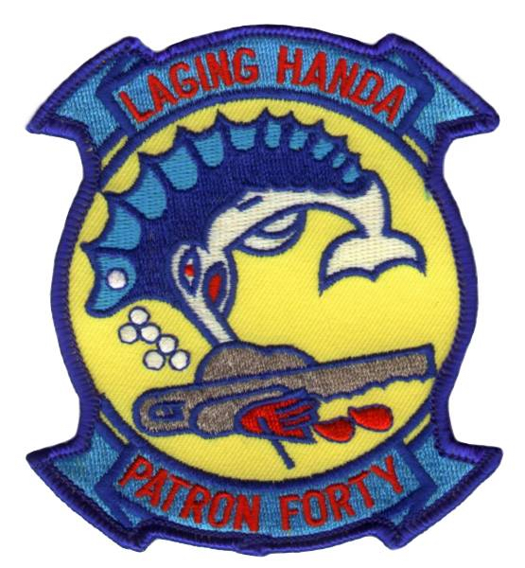
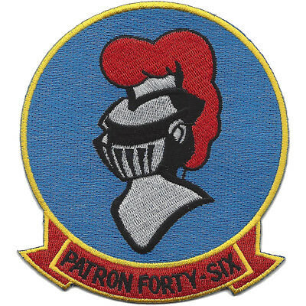
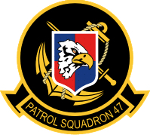


Seven P-3 squadrons were assigned to Moffett Field, each with nine aircraft.

Slide 38


Moffett also became home for the west coast and Pacific P-3 training squadron (VP-31), plus one Naval reserve P-3 squadron (VP-91).

Slide 39


Active Duty Commands
Naval Reserve Commands
Along with the P-3’s, the headquarters for the command structures of the Navy’s Pacific patrol wings, both active and reserve, were relocated to Moffett.

Slide 40

A typical P-3 squadron had nine aircraft and more than a dozen flight crews.

Slide 41
Flying personnel would be assigned to specific crews for as long as possible. This was for cohesion and consistency, and to gain and maintain readiness qualifications awarded to the whole crew as one entity.

Slide 42

P-3A
P-3B
P-3C
The chronological versions of the P-3’s based at Moffett were the P-3A, P-3B, and P-3C.

Slide 43
P-3A
P-3B
P-3C
As can be seen, the airframe changed very little. The real differences were in the form of electronic upgrades and more powerful engines.

Slide 44

The C variant was the first that integrated missions systems with a central digital computer.

Slide 45
Also new with the “C” was inertial navigation, a new ASW suite, and new interior layout.

Slide 46

Entering service in the late 1960s, the “Charlie” was the longest lived of the three variants, and went through several substantial changes in electronics, sensors, and weapons.

Slide 47

The P-3C wasn’t phased out of front-line service until 2019 when the new P-8A became fully operational.

Slide 48
The active duty P-3’s flew from Moffett Field from 1963 until the Navy closed its active operations there in 1994. This was a period of over thirty years. No other aircraft type was based at Moffett for that long a period. The reserve P-3 squadron, however, remained at Moffett until 1999.

Slide 49

The active duty P-3’s flew from Moffett Field from 1963 until the Navy closed its active operations there in 1994. This was a period of over thirty years. No other aircraft type was based at Moffett for that long a period. The reserve P-3 squadron, however, remained at Moffett until 1999.

