Slide 1

History of Moffett Field Museum
James Parrish, Sherwin Dinakar

Slide 2
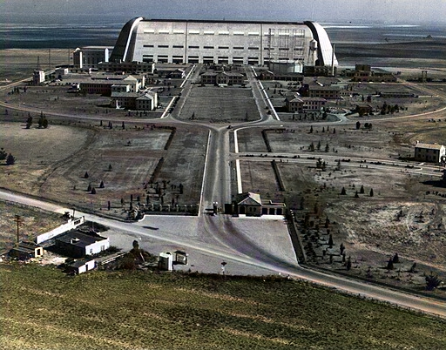
AIrbase sunnyvale CAL
* Airbase Sunnyvale CAL Aerial View
Airbase Sunnyvale CAL, is now called Moffett Field.
Funds of over 400 thousand were collected, but the land was only purchased for 1$ by the US Navy in 1931.

Slide 3
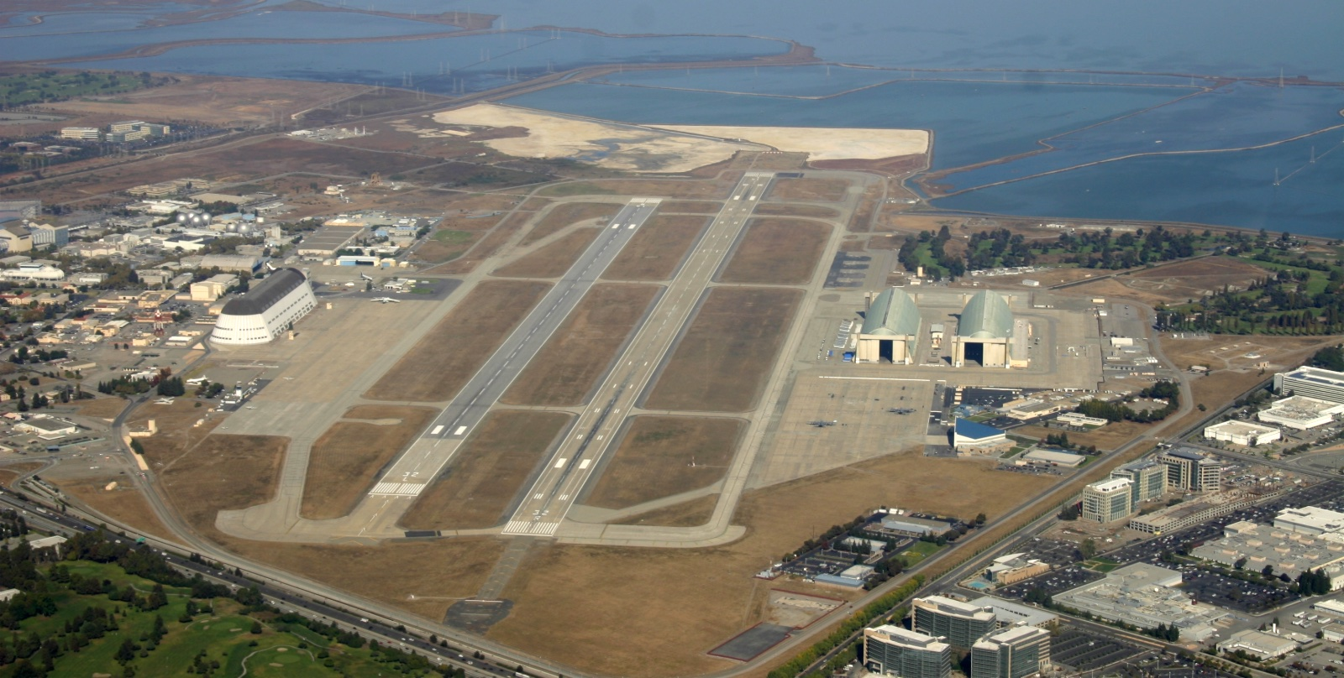

Slide 4
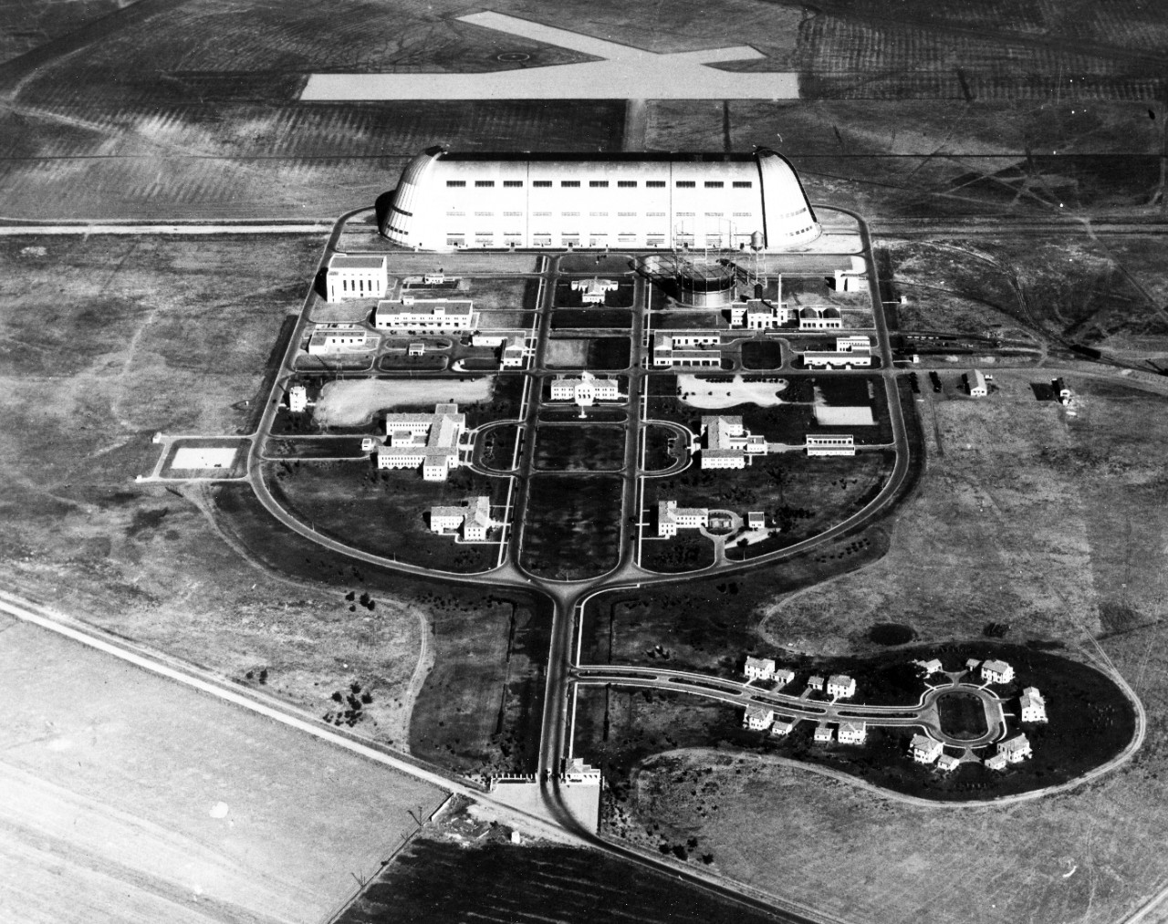
Moffett Field Museum
The museum was created around a year later with the help of several enthusiastic volunteers.
It was originally located in the west side of Hangar One, staying there until January 2002, when it was shut down after finding hazardous materials found in the structure.

Slide 5
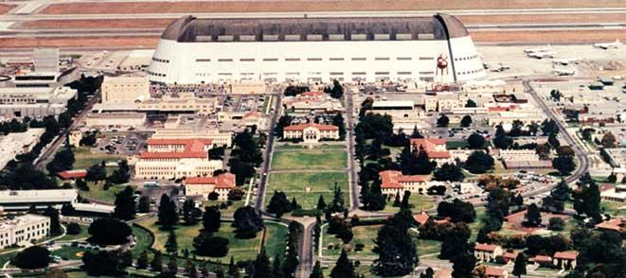

Slide 6
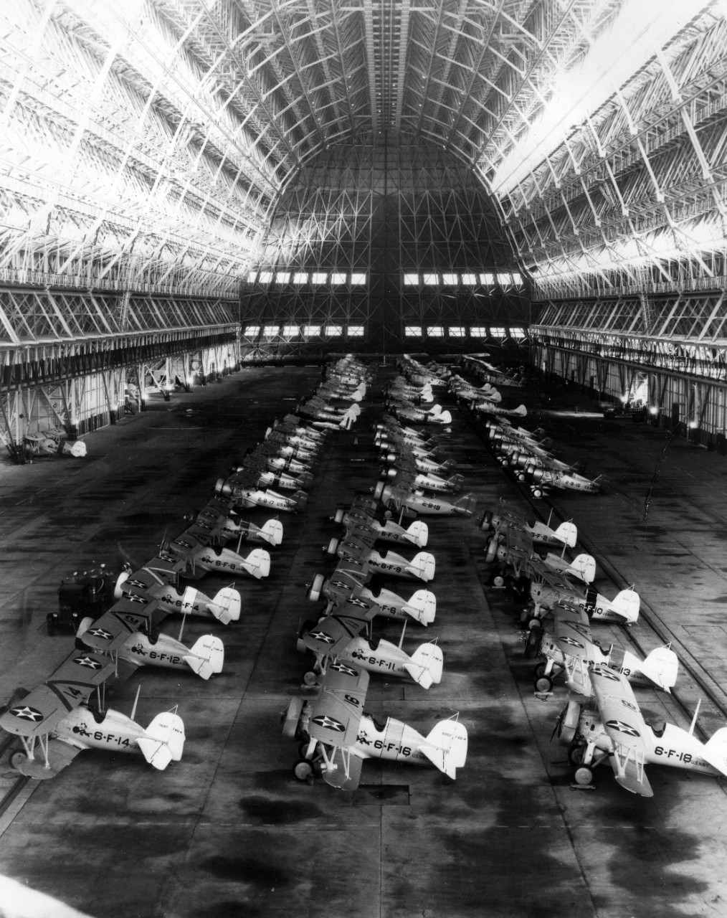
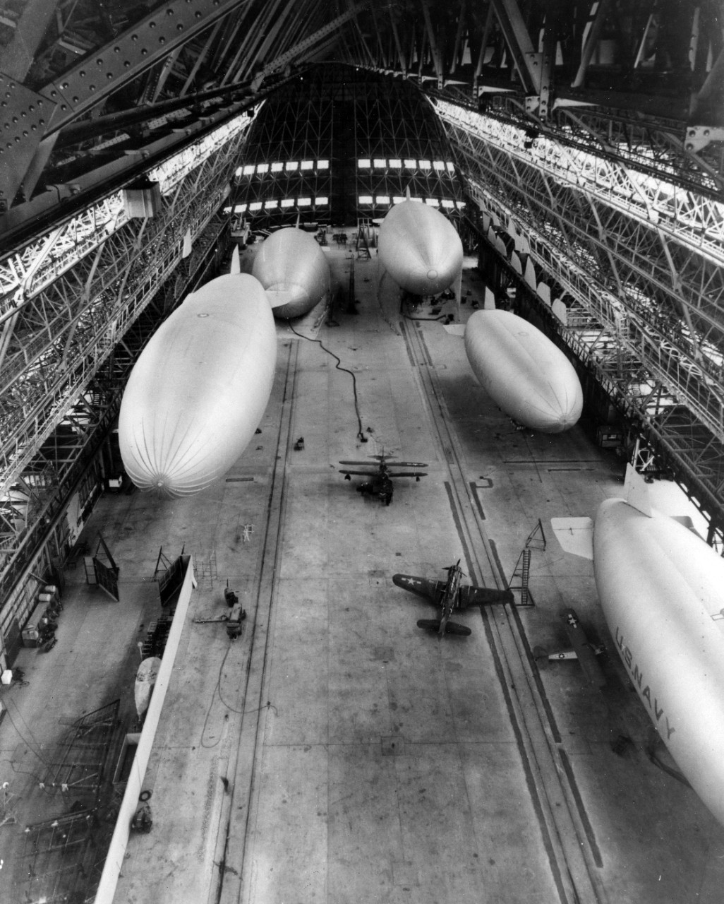
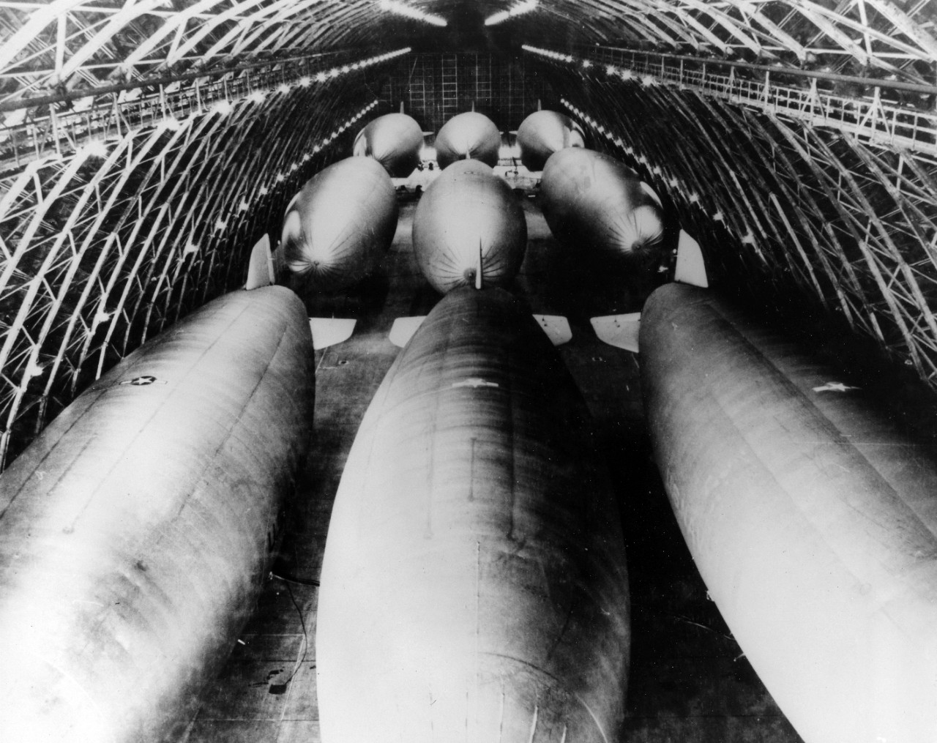
Hangar 1
*Interior look of Hangar 1 with a squadron of F9C Sparrowhawks.
Hangar 1 was constructed in the early 1930s.
The hangar served multiple purposes including, becoming home to the USS Macon, F9C Sparrowhawks, and other military grade aircrafts and vehicles.

Slide 7
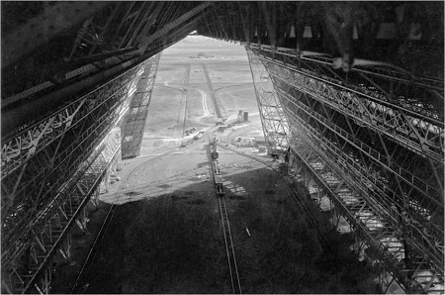

Slide 8
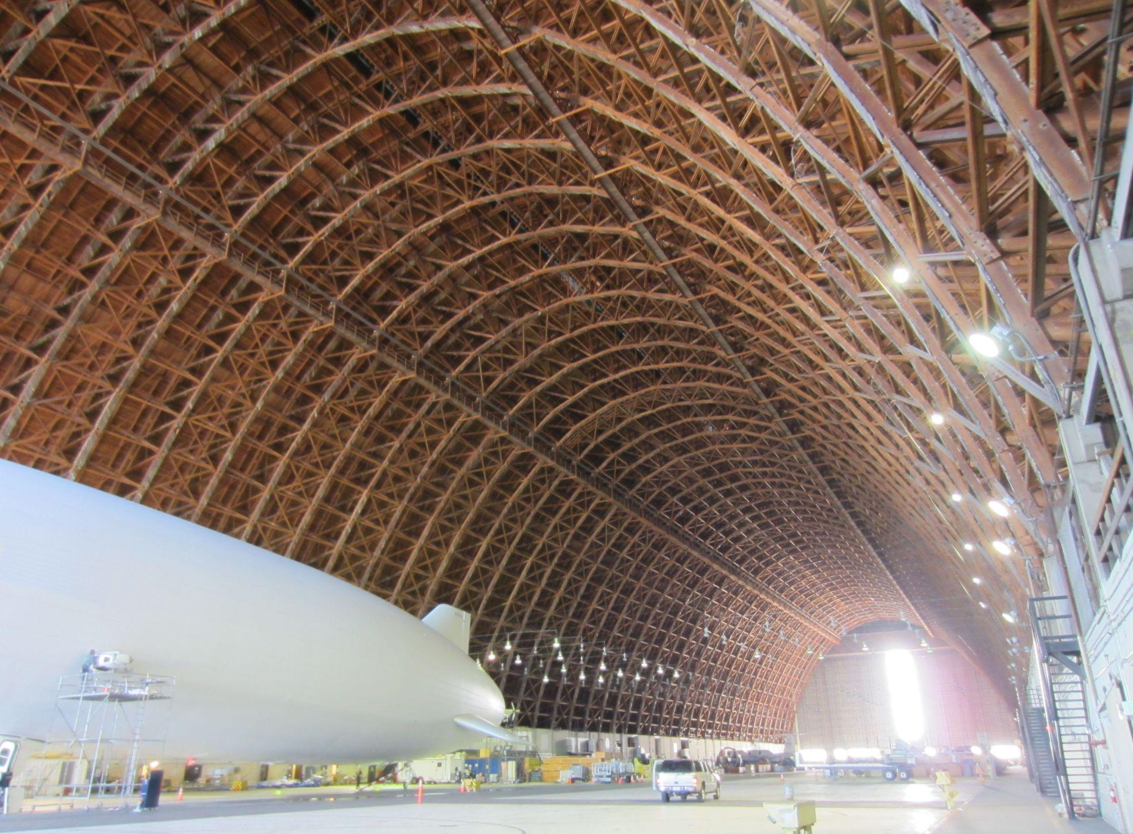

Slide 9
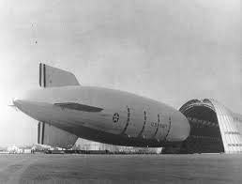
USS MACoN
* USS Macon parked in front of Hangar 1
Naval Air Base CAL, now called Moffett Field, was home to the USS Macon.
The Macon was a lighter-than-air ship that was active for almost a year and a half.

Slide 10
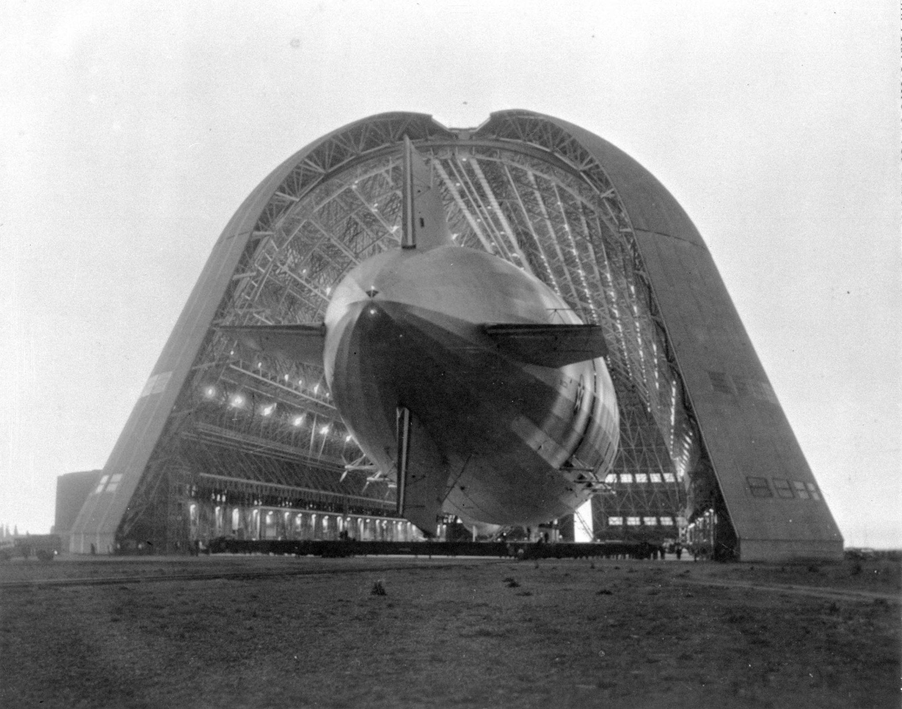

Slide 11

Computer mockup
You can replace the image on the screen with your own work. Just right-click on it and select “Replace image”

Slide 12
Thanks
Do you have any questions?
youremail@freepik.com
+91 620 421 838
yourwebsite.com
Please keep this slide for attribution

